Slide 1
To avoid any technical difficulties and to listen in without any problems, please login through WebEx first before calling in.
You may be able to call in through your phone or computer. The number to use to call in is to the right of this screen.
Use this Access Code to join: 664 994 032 #
And your individual ID number was emailed to you.
If you have any technical issues or concerns, please private chat with global genes in the chat box or email Amanda at amandak@globalgenes.org
US TOLLFREE
+1-855-749-4750
US TOLL
+1-415-655-0001

Slide 2
Submit Your Questions
Throughout the webinar, panelists will be taking questions from the audience
To send in questions, please use WebEx’s Q&A feature in the bottom right hand corner
Please feel free to submit questions throughout the presentation

Slide 3
Introducing Dr. Petra Kaufmann NCATS ORDR
Tuesday, November 17, 2015

Slide 4
Who is Global Genes?
To Eliminate the Challenges of Rare Disease.

Slide 5
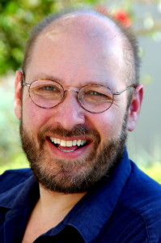
Introducing Dr. Petra Kaufmann
Daniel Levine
Founder & Principal,
Levine Media Group

Slide 6
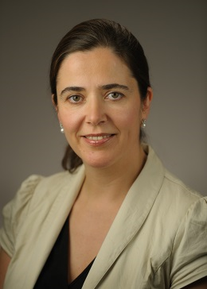
Introducing Dr. Petra Kaufmann
Dr. Petra Kaufmann
Director,
NCATS Office of Rare Disease Research and
Division of Clinical Innovation

Slide 7
Introducing Dr. Petra Kaufmann
Dr. Petra Kaufmann
Director,
NCATS Office of Rare Disease Research and
Division of Clinical Innovation

Slide 8
Introducing Dr. Petra Kaufmann

Slide 9
Introducing Dr. Petra Kaufmann
Question and Answer

Slide 10
Submit Your Questions
Throughout the webinar, panelists will be taking questions from the audience
To send in questions, please use WebEx’s Q&A feature in the bottom right hand corner
Please feel free to submit questions throughout the presentation

Slide 11
Introducing Dr. Petra Kaufmann
Thank you for joining!
This webinar was recorded and will be available at http://globalgenes.org soon.

