Slide 1


Do I have the right models to advance my therapeutic development
Dana Layo-Carris, PhD
Rare Disease Translational Center, The Jackson Laboratory
#RDDS26

Slide 2
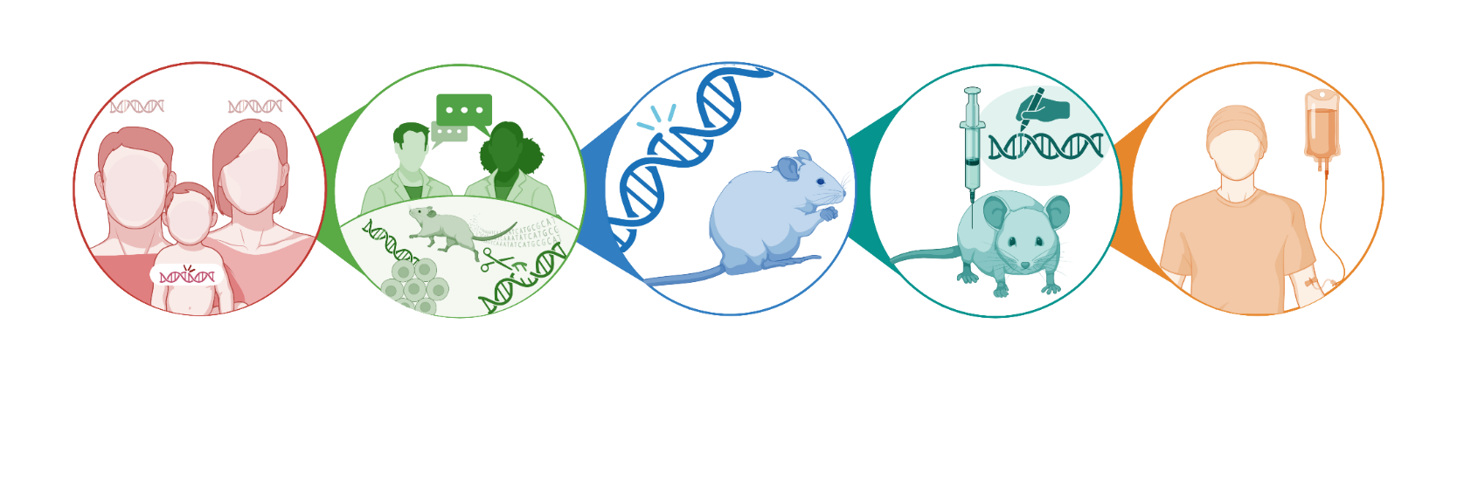
Building a Tool Box
Identified patient variants
Anticipate genetic therapy
Engineer the mouse model /cell lines
Phenotype and test therapeutics
Preclinical data supports investigational new drug (IND)
#RDDS2026

Slide 3
What is the goal of this workshop?
High-level overview of rare disease models
Goal: Identify which questions need to be asked
There is no single “right” model for any given disorder
Models are tools – each one answers different questions

Slide 4
Models can help us answer:
What does this gene do in our body?
How do variants in the gene change its function?
How can we treat the genetic disorder?
What types of therapeutics are feasible?
Is the therapeutic effective?
What is the best therapeutic dose?
When is the best time to deliver the therapeutic?
*Critical components of an IND application
#RDDS2026

Slide 5
As we build the toolbox
Do we know the gene and mechanism?
Are we testing mechanism or treatment?
Is behavior a key outcome? Clinical trial endpoints
What therapies are being considered?
What data will regulators eventually expect?
Begin with the end goal in mind
The question you need answered should drive the model — not the other way around.
#RDDS26

Slide 6




Therapeutic Modalities
*Drug Repurposing
mRNA
Antisense Oligos
RNA Editing
DNA
Gene Replacement Therapy
Base Editing
Prime Editing
Proteomic
Enzyme Replacement
Substrate Supplement
Knockdown and
Replacement

Slide 7
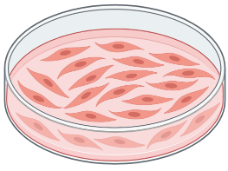
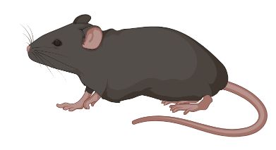
Cellular (in vitro) vs mouse models (in vivo):
Model type | Best for | Limitations
Cells / induced pluripotent stem cells (iPSCs) | Fast answers, mechanism, screening | Not whole-body, no behavior, no immune system
Organoids | Human-specific development | Still simplified systems
Mouse models | Whole-organism effects, dosing, safety | Time, cost, complexity

Slide 8
Cellular Modeling
Reference Immortalized Cell Lines
Pro: Easily Accessible, Characterized, and Easily Modified to contain patient variants
Con: Does not contain patient genetic context
Example: HEK293T;SH-SY5Y Cells
Patient Primary Cells
Pro: Contains patient genetic info, can be immortalized to be studied for many years
Con: Painful to acquire, can be difficult to navigate
Example: fibroblasts, any biopsies
Reference iPSCs
Pro: Characterized and Easily Modified to contain patient variants
Con: Does not contain patient genetic context, can take ~8 months to generate
Example: KOLF2.1J (JAX)
Patient Derived iPSCs
Pro: Contains patient genetic info, can be differentiated into any cell type
Con: Can take 8 months to generate, requires biopsy/blood draw
#RDDS26

Slide 9
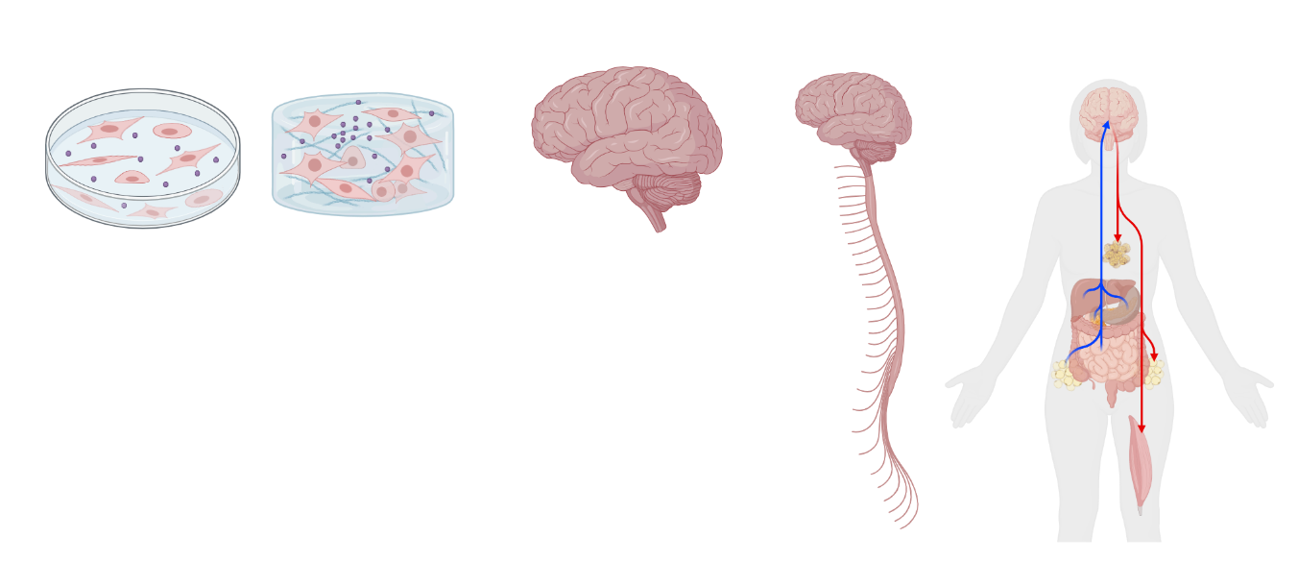
What do you need from your system?
Organ System
Mutli-Organ System
2D
3D
Organ
Increasing complexity

Slide 10
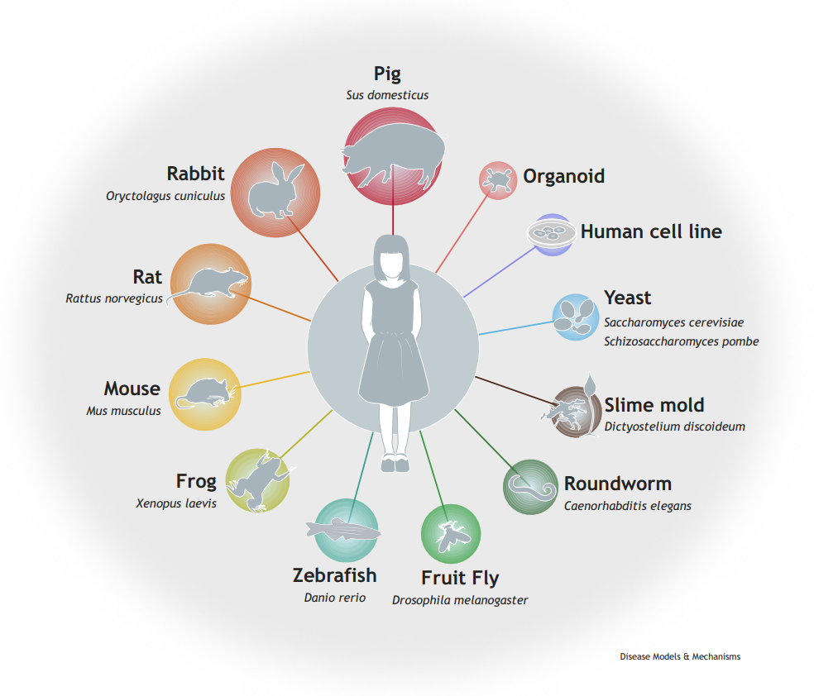
There are many options for model systems…
Hmeljak and Hooper, DMM 2024.

Slide 11
What kind of mouse models exist?
Knock-in (KI) model: patient-specific variant is introduced directly into the mouse DNA
  Often contains humanization of the sequence around the variant, to be helpful in testing genetic altering therapeutics
Knock-out (KO) model: null/loss of function or variant causing nonsense mediated decay resulting in no protein is introduced to the mouse DNA
  Often do not need to be humanized ** caveat is when LOF variants are KI
Conditional model: variant expression is controlled by time (in utero vs post-natal) or tissue (brain, heart, skeletal muscle, etc) via cre driver
  Useful for genes with critical function that may cause lethality in mouse models when always expressed throughout the entire body or during embryonic development
#RDDS2026

Slide 12
Does a mouse model exist already that we can use? Or do we need to create a new one?

Slide 13
Does a model exist or do a I need a new one?
Before building a new model, ask:
Has this gene already been modeled in mouse?
Does an existing model reflect the disease mechanism?
  Loss of function – broken or missing vs Gain of Function – doing too much, too often, or doing something it should never do
Does it support the therapy type we’re considering?
Are there access or licensing restrictions?
Existing models may be sufficient if:
They capture key biology or phenotypes
They can answer your near‑term question
You can access them in a reasonable timeframe
Many mouse models are available through public repositories (e.g., JAX, MMRRC), which can reduce time and administrative burden
New models may be needed if:
The variant is patient‑specific
Precision therapies require humanized sequence
Existing models don’t show usable phenotypes
You need control over design, access, or timelines
#RDDS26

Slide 14
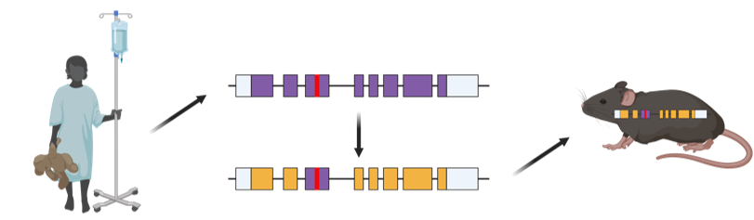
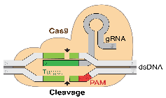
What does humanization of a mouse gene mean?
Mouse DNA
+
Human DNA
CRISPR Cas9
Human DNA
#RDDS26

Slide 15

How to make a humanized mouse
Human GSLAANGPTTLVDK-VSNPKTNGDSQQPSSSGLASSK
||.|.||||||||| :|:||.| :|.||.|||.|||.
Mouse GSFAVNGPTTLVDKKISSPKCN-NSNQPPSSGPASST
mouse DNA to be excised & replaced with human DNA
WT Mouse
4
5
6
WT Humanized Model (G114G)
35nt
4
46nt
h5
5
6
81 bp humanized DNA
Variant Humanized Model (G114D)
35nt
4
46nt
h5
5
6
*
G114D
81 bp humanized DNA

Slide 16
When would you use these models?
Knock-in (KI) model:
  Humanize around variant for Base/Prime Editing or ASO allele specific therapeutics
  Can be used for drug repurposing
  Non-humanized can still be used for understanding ASO/editing strategies (mouse specific) & disease pathology
Knock-out (KO) model: null/variant causing nonsense mediated decay resulting in no protein is introduced to the mouse DNA
  Often do not need to be humanized
Conditional model: variant expression is controlled by time (in utero vs post-natal) or tissue (brain, heart, skeletal muscle, etc) via cre driver
  **can be humanized (see KI model above)

Slide 17
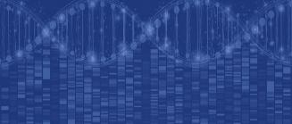








What can these models do?
Target Engagement
Target Validation and Biomarker Discovery
Dose Ranging and Biodistribution
Toxicology and Optimization
Preclinical Efficacy
Clinical Candidate and IND Package
-Omics, Targeted Analyses, and
Biomarker Discovery
Mouse Phenotyping and
Physiological Characterization
Computational Biology and
in silico drug design
Tissue Analysis and Diagnostic
Services
Genetic Engineering and Disease Model Development
Protein and Antibody Production
and Evaluation
Cellular Profiling and Screening
Sample Collection, Injections,
and Procedures

Slide 18
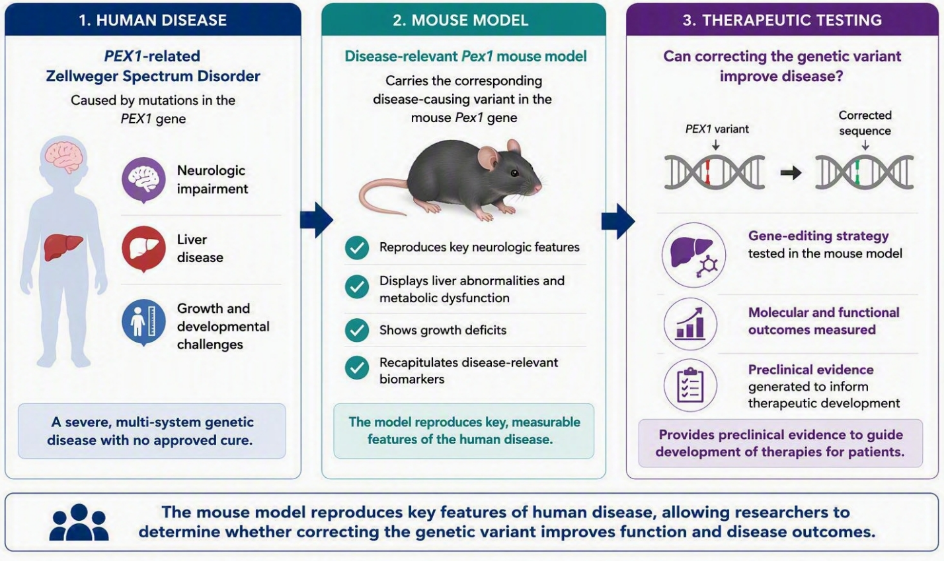
Case Study: Zellweger Spectrum Disorder (PEX1) - From Mouse Model to Therapeutic Proof of Concept
Gao, X., et al., Nature Biomedical Engineering, 2026; Image from: Ahrens-Nicklas, New England Journal of Medicine, 2026
#RDDS2026

Slide 19
Models can help us answer:
What does this gene do in our body?
How do variants in the gene change its function?
How can we treat the genetic disorder?
What types of therapeutics are feasible?
Is the therapeutic effective?
What is the best therapeutic dose?
When is the best time to deliver the therapeutic?
*Critical components of an IND application
#RDDS2026

Slide 20
Additional Slides
#RDDS2026

Slide 21
Mouse Model Development Process & Timelines
From Day 1 of model generation, it likely will be 1 year (minimum) before the mice are ready for any testing.
  Any unexpected challenges can increase this timeline.
  Redirections aren’t failures — they often clarify what will and won’t move a therapy forward
  Cost scales with complexity
Engineering
Breeding
Colony Expansion
Characterization
Preclinical Studies
#RDDS2026

Slide 22
Engineering – Additional Considerations
Humanization
  Relevant when therapies require human-specific sequence
    (ie. Antisense oligonucleotides (ASO) or genome editors)
Strain/genetic background
  Different strains of mice are more or less susceptible to various features (seizures, blindness, etc).
#RDDS2026

Slide 23
Characterization
Once we have mice with the genetic variant available, we need to establish if the animals display features that can model human disease symptoms
We will consider:
  Molecular impacts: protein expression, cellular function
  Physical impacts: lifespan, size, appearance, fertility
  Behavioral impacts: coordination, activity levels, learning and memory
Engineering
Breeding
Colony Expansion
Characterization
Preclinical Studies
#RDDS2026

Slide 24
Preclinical Studies
After a colony is established with characterized, measurable features, we’re ready to perform preclinical studies to support an IND application!
This work is critical in determining:
  What route of administration leads to the best tissue/cell type targeting (Biodistribution)?
  Does the therapy have its intended effect when it gets to the target tissues/cell types? (Target engagement)
  If it has its intended effect, does it improve phenotypes and/or correct biomarkers relevant to the disease?
  How much of the therapeutic is needed to get improvement (Dose ranging)
  At what levels is the therapeutic safe? At what levels is it not safe and what toxic effects are observed?
  At what age(s) is the treatment effective?
Engineering
Breeding
Colony Expansion
Characterization
Preclinical Studies
#RDDS2026

Slide 25

Resources
Model discovery (where to look first):
Mouse Genome Informatics (MGI)
Links genes, variants, phenotypes, and available mouse alleles
International Mouse Strain Resource (IMSR)
Global search tool showing which repositories hold existing mouse models
Public mouse repositories (examples):
JAX (U.S.)
MMRRC (U.S.)
EMMA (Europe)
RIKEN BioResource Center (Japan)
Optional Education:
https://www.jax.org/education-and-learning/course-and-conferences/minicourses
https://resources.jax.org/jax-on-demand
(examples: Generating Better Preclinical Research Models: Approaches & Considerations, Exploring
Rare Disease Through Translational Research, Generating Mouse Models Using CRISPR/Cas9
Technology)
Rare Disease Translational Center, JAX
raredisease@jax.org
#RDDS2026

