Slide 1


September 9 – 11, 2026 | Boston, Mass

Slide 2

Endpoint Development in Clinical Trial Preparation
#RDDS2026

Slide 3


Endpoint Development in
Clinical Trial Preparation
Mustafa Sahin, M.D., Ph.D.
Boston Children’s Hospital
Audrey Thurm, Ph.D.
Boston Children’s Hospital

Slide 4
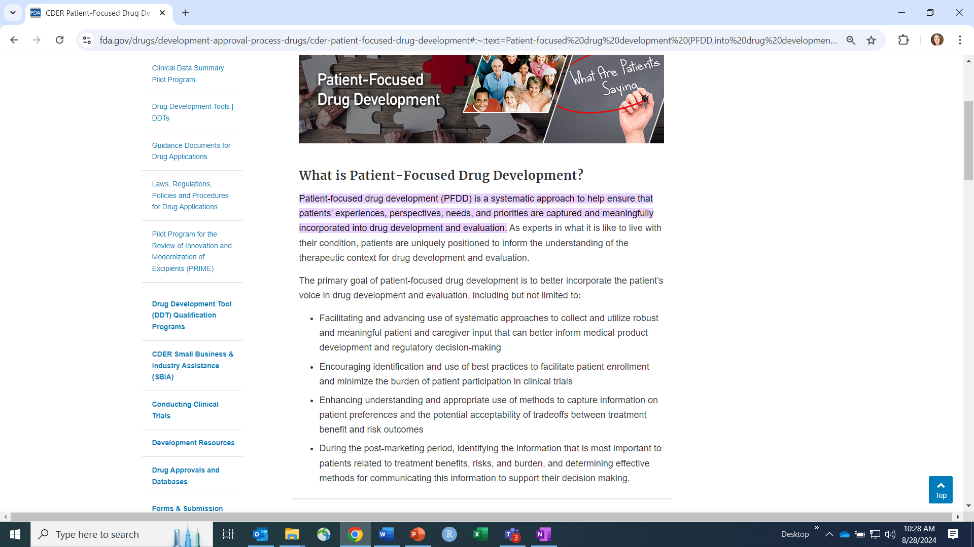
https://www.fda.gov/drugs/development-approval-process-drugs/cder-patient-focused-drug-development#:~:text=Patient%2Dfocused%20drug%20development%20(PFDD,into%20drug%20development%20and%20evaluation.

Slide 5
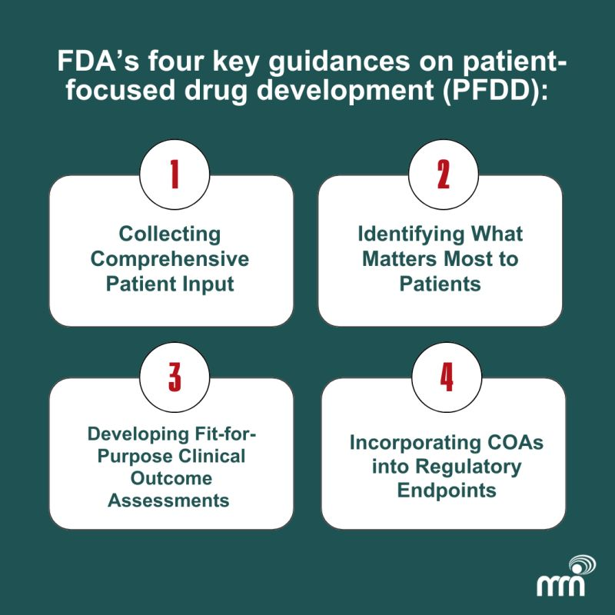
FDA’s Framework for Approach to Clinical Outcome Assessments

Slide 6

FDA Patient-Focused Drug Development Guidance Series for Enhancing the Incorporation of the Patient’s Voice in Medical Product Development and Regulatory Decision Making
Guidance 1: Collecting Comprehensive and Representative Input
Guidance 2: Methods to Identify What is Important to Patients
Guidance 3: Selecting, Developing or Modifying Fit-for-Purpose Clinical Outcomes Assessments
Guidance 4: Incorporating Clinical Outcome Assessments into Endpoints for Regulatory Decision Making
#RDDS2026

Slide 7
Guidance 3: includes Roadmap to Patient-Focused Outcome Measurement in Clinical Trials
Available at https://www.fda.gov/regulatory-information/search-fda-guidance-documents/patient-focused-drug-development-selecting-developing-or-modifying-fit-purpose-clinical-outcome

Slide 8
The study endpoint is the quantity used to judge statistical significance – does the effect seem to be more than just random noise?
#RDDS2026
FDA, PFDD Guidance #3 Snapshot
https://www.fda.gov/media/159516/download#:~:text=%E2%80%A2%20Concept%20of%20Interest%20is,the%20COA%20is%20intended%20to
Notes:
Points of this slide
But it’s not just the COA itself that you have to consider, it’s how you’re operationalizing performance on that COA – the score – and all of the other aspects of the endpoint, like timing
These things dramatically affect the validity and responsiveness of COA. So, I’m going to be really thinking about the endpoint, rather than the COA in isolation, when I evaluate the psychometric argument

Slide 9
Meaningful Aspect of Health
aspect of how a patient feels, functions, or survives in daily life that is important to them
Ex: pain, developmental delays
Concept of Interest
The exact variable or target that a test, sensor, or questionnaire
Communication, cognition, or more specific?
#RDDS2026
FDA, PFDD Guidance #3 Snapshot
https://www.fda.gov/media/159516/download#:~:text=%E2%80%A2%20Concept%20of%20Interest%20is,the%20COA%20is%20intended%20to
Notes:
Finally, before turning it over to Dr. Thurm, I want to finally define a word that I’ve already used a few times, “endpoint.” During our time today, we will talk about maximizing both COAs and more specifically, the endpoints using those COAs. The endpoint is the precise variable being used to support the efficacy argument to the FDA, so this is referring to the use of the COA in the statistical model.

Slide 10
Systematic Review:
Conditions included in the analyses
Condition | Short Name
Cyclin-dependent kinase-like 5 deficiency disorder | CDKL5DD
Dravet Syndrome | DS
STXBP1 | STXBP1
Metachromatic Leukodystrophy | ML
Cerebral Creatine Deficiency Syndromes: L-arginine:glycine amidinotransferase deficiency, guanidinoacetate methyltransferase deficiency, and creatine transporter deficiency | CCDS
Classical Homocystinuria | CH
Galactosemia | Galacto
GM1 gangliosidosis | GM1
GM2 gangliosidoses (Tay-Sachs and Sandhoff diseases) | GM2-Inf, GM2-Late
Mitochondrial Disease | Mito
Fragile X Syndrome | FXS
Phelan-McDermid Syndrome | PMS
Rett Syndrome | RS
Tuberous Sclerosis Complex | TSC
Farmer et al., 2026

Slide 11
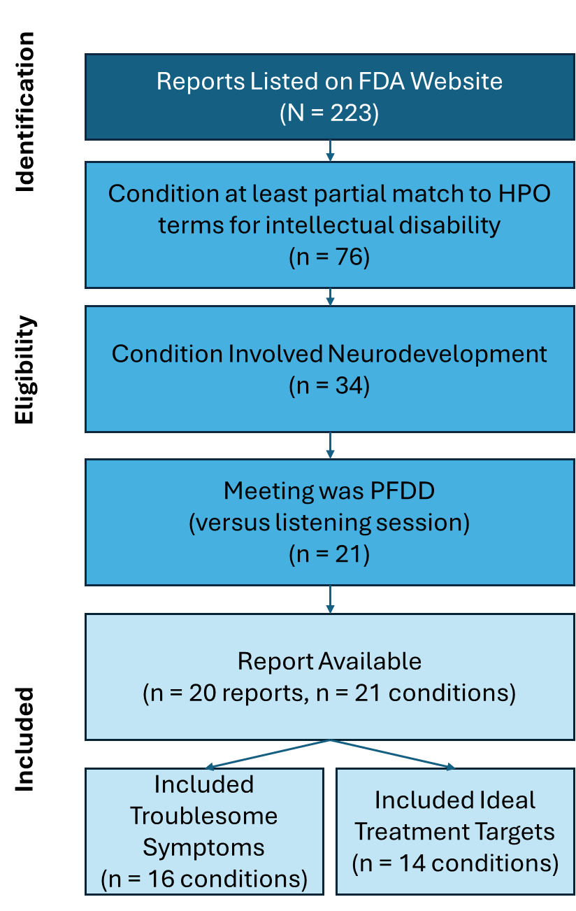
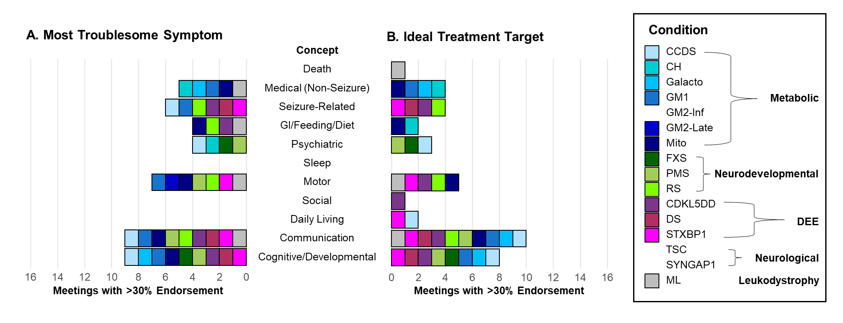
Developmental concepts were commonly endorsed across most conditions
Farmer et al., 2026
Note: Conditions with no color did not endorse any concept at a rate >30%

Slide 12
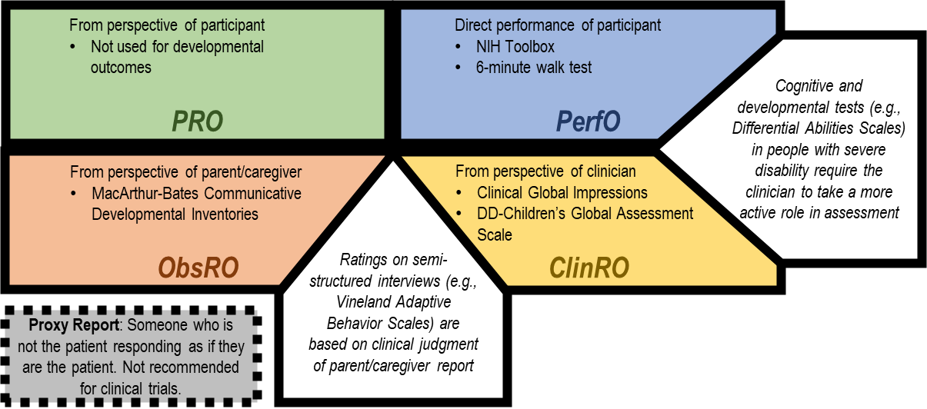


FDA’s Categorization of Clinical Outcome Assessments
Note; Categories of clinical outcome assessment. Schematic illustrates how COAs may be categorized based on the responder, and that COAs for developmental concepts often combine aspects of more than one category. For each category, examples of COAs sometimes used in CGAND or neurodevelopmental disability studies are provided.
Farmer et al., 2022; International Review of Research in Developmental Disabilities
Notes:
PRO= patient reported outcome
PerfO = performance based outcome assessments

Slide 13

Why is this especially challenging in Genetic Conditions Associated with Neurodevelopmental disorders (GCAND)?
Heterogeneous
Developmental
Rare
Single COI often elusive
Validity and responsiveness of common solutions – including most disease severity scales – is often lacking
  COAs that cover multiple discrete COIs
  “composite endpoints” that combine multiple COAs
Multiple endpoints reduces power
Timing of endpoint really matters
COI and COA selection can depend heavily on individual factors
Even for single COI, often no single COA that will work for everyone
Interconnectedness of outcomes – improvement in one COI may cause “worsening” in another
Burden to show that existing COAs valid for your context
If no valid COA, must create new
Either way – techniques usually require large samples!
#RDDS2026

Slide 14
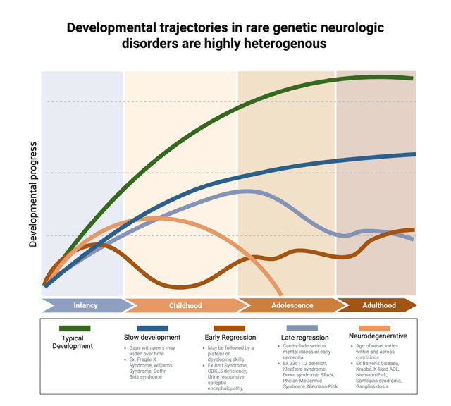
Baribeau et al., in preparation

Slide 15
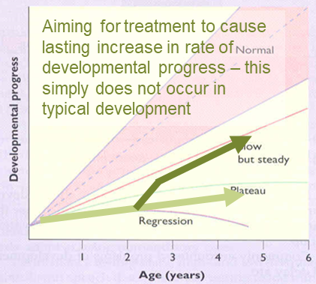
How do developmental constructs fit into the FDA paradigm?

Slide 16
Patient Advocacy Groups and networks of PAGS together are critical to this process
from: Philanthropic drug development: understanding its importance, mechanisms, and future prospects
Reichel, Murauer, Steiner, Coch & Trübel, 2025

