Slide 1




September 9–11, 2026 | Boston, Mass

Slide 2



12:15–1:30 PM
From Community Insight to Scientific Impact:
Publishing & Amplifying Rare Disease Evidence
Rohita Sharma
PhD
Soniya Patel*
PhD
*Soniya Patel is presenting on behalf of Hélène Dassule who was involved in the preparation of this material.

Slide 3
DISCLAIMER
The views and opinions expressed in this presentation are those of the presenters alone and do not necessarily reflect the official policy, position, or views of AstraZeneca. The content is intended for informational purposes only and should not be interpreted as representing AstraZeneca’s corporate stance on any topic discussed.

Slide 4
Your Experience, Goals & Questions
1
Have you ever published research,
survey results, registry data, or other
patient-generated evidence? If so, what was your experience?
2
What are you hoping to gain from today’s session?
3
Are there any specific questions related to publishing that you would like us to address today?
Plan for a marathon not a sprint

Slide 5
1
Why Publish?
2
Planning
3
Writing
4
Submission and Beyond
Notes:
75 minute session
15 minute lunch and Intro?
15 minutes per session
10 minutes White boarding
5 minutes Presentation

Slide 6
Why Publication Matters: Driving Visibility, Credibility, and Change
Evidence can only influence science, policy, and care when it is published
Key benefits
Ensures patient and community perspectives are represented in the scientific literature
Shapes research priorities and influences agendas
Contributes to the development of treatments, care, and policies that matter to the rare disease community
Notes:
Rohita
Your Research Is Complete – What Now?

Slide 7

Planning
What do you need to know and do before you start writing?
Plan for a marathon, not a sprint

Slide 8
Could Your Research Be Published?
Considerations before you start your publication journey
The data were collected in a systematic and credible way
The findings tell a clear and meaningful story
If patient data and stories are included, the appropriate permissions have been given
Participants have provided appropriate consent
Patient privacy and confidentiality are protected

Slide 9
What Gets Published
Types of publications in medicine
Journal articles – also known as manuscripts
Original Research Articles
Case Reports
Review Articles
Editorials & Commentaries
New data from research or studies
Detailed accounts of individual patient cases
Summaries and syntheses of existing evidence on a topic
Expert opinion and context around published findings

Slide 10
Building Your Author Team
A thoughtful author byline ensures patient, clinical, and research perspectives are appropriately represented
Patients, advocates, researchers, and clinicians can all be authors when they make substantial contributions to the work and in general
Contributed to the study design, conduct, analysis, or interpretation
Helped develop or review the manuscript
Approved the final version
Agreed to be accountable for all the content in the publication
Notes:
Having a strong mix of authors is important, especially as you think about these people as representing this work across speaking engagements, conferences etc.
Being an author There are several criteria that need to be fulfilled. In general…
We will share the full criteria in a link.

Slide 11
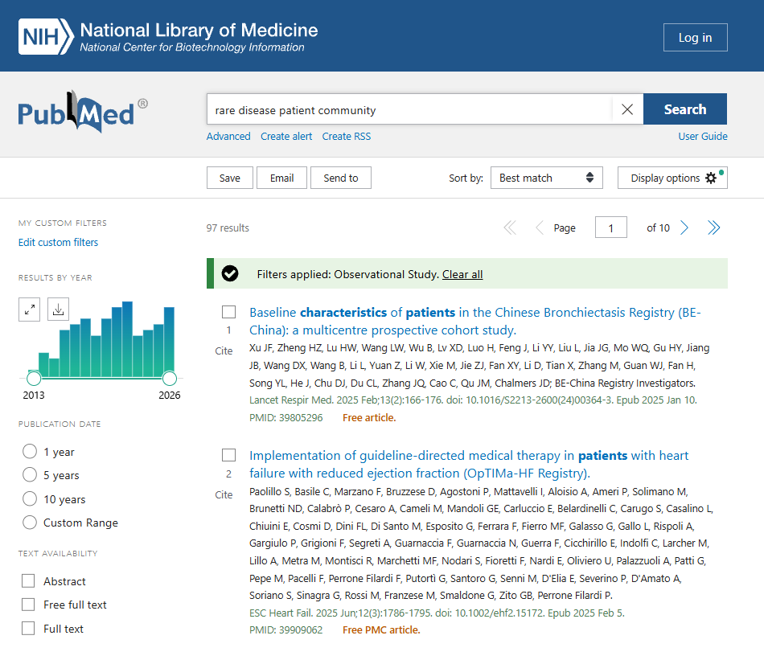
Choosing the Right Journal
Reach the AUDIENCE that can act on your findings
Review similar publications on PubMed
Anticipate and plan for rejections
Considerations for choosing a journal:
Does it accept your type of research? Example: Not all journals accept case reports
What is its impact factor? Who reads it and does it influence your target audience?
Does it provide an Open Access options? To increase visibility and accessibility
Choose a journal based on the audience you want to influence, not just its impact factor.

Slide 12
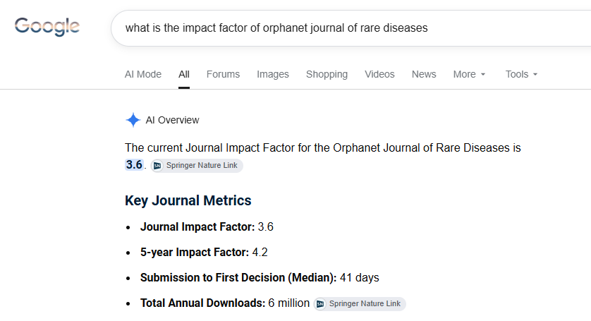
What is the Impact Factor?
A measure of impact – a proxy for acceptance rate
General Benchmarks in Medicine
Fair or Respectable (1.0 – 3.0): The research is read and cited by peers in a narrow niche.
Good to Very Good (3.0 – 6.0): Solid performance for established clinical specialties
Great to Excellent (6.0 – 15.0): High-tier specialized journals or strong general clinical journals.
Elite / Top-Tier (15.0 to 90+): The New England Journal of Medicine (NEJM), The Lancet, and JAMA
Not sure if you have picked right? Send a
pre-submission enquiry to the editor. Tell them what the paper is about and why is it important

Slide 13
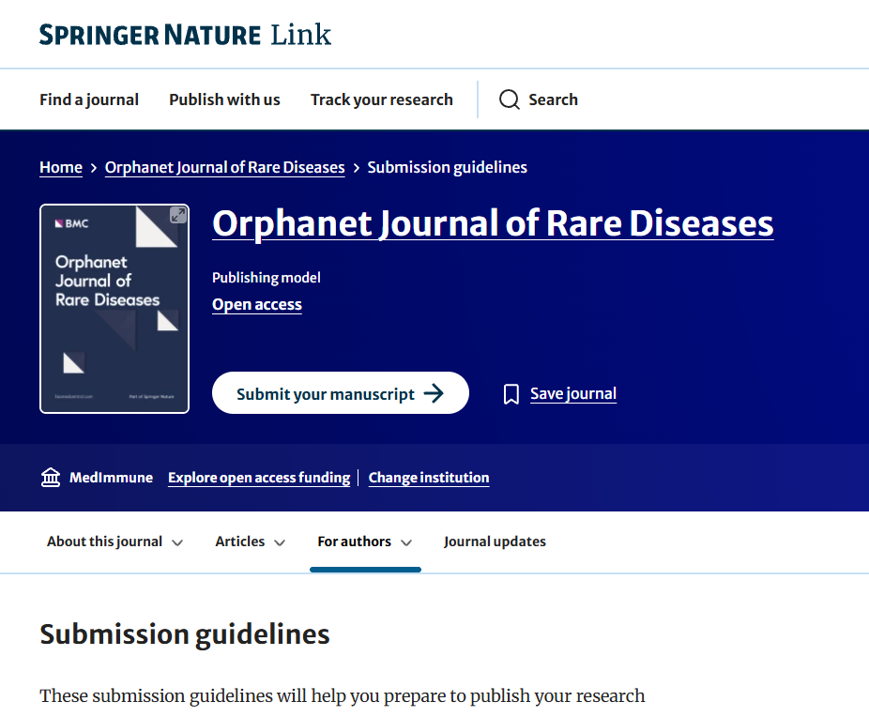
When Research is NOT Behind a Paywall: Understanding Open Access
A publishing model that makes scientific research, data, and findings freely available online, without paywalls or subscription barriers
Benefits:
Makes research accessible to patients, caregivers, advocates, clinicians, and researchers
Can increase the visibility and reach of your publication
Accelerates the dissemination of clinical and scientific findings
Helps ensure the communities who contributed to the research can access the results
What about the cost? Publication fees should be considered early during project planning and budgeting.
Notes:
ssss

Slide 14
Beware of Predatory Journals
Definition
Warning signs to watch for
Pay-to Publish model
Fake or low-quality journals that do not provide real peer review or editorial standards
They exist to make money, not advance science
No scientific credibility
Unsolicited emails inviting submission with promises of rapid publication
Not indexed in PubMed or other reputable databases
Fees requested upfront with no transparency
https://beallslist.net/

Slide 15
Table Discussion
Worksheet
Sections 1–4

Slide 16

Writing
Telling your research story

Slide 17
Before You Start Writing
Check journal requirements
Length
Tables and Figures Number
Even if the journal says word count is unlimited, stick to these guidelines
Recommendation
3,500 words for a research paper
5,000 words for a review article
Abstracts – characters with or without spaces
3–4 figures & 2–3 tables
Is the use of AI allowed?
It depends on the journal (check the policy of ALL the journals you have selected before you use AI)
Consider confidentiality of your data before putting it into an open/public AI
Beware of accuracy
Beware of plagiarism
Aways disclose its use in the manuscript
Do not list AI on the author byline
Do you want to use a medical writer?
Be clear on the story you want to tell
What evidence do you want to include?
Make sure the story is balanced

Slide 18
Sections of a Journal Article
What sections are required?
Practical writing tips:
Title page
Abstract
Key words
Introduction
Methods
Results
Discussion
Conclusions
Acknowledgements
Disclosures
References
Tables and Figures
Supplemental Material
Don’t feel you need to write the paper in order. Start with the section you know best.
Capture ideas as they come to you, even if they belong in different sections.
Scientific writing is not a literary exercise. No thesaurus required.
Focus on clarity, not creativity. Use plain, precise language and keep sentences short and concise.
Start each paragraph with a clear topic sentence

Slide 19
Ethics Disclosures
Ethics needs to be included in all publications that include people
Patient/community research must follow the same ethical safeguards as pharma led research to protect participants and communities
Ethics Committee/IRB approval
Participant informed consent
To be involved in research
To have data used in a publication
Patient privacy and confidentiality
Eg, de-identified data

Slide 20
Table Discussion
Worksheet
Sections 5

Slide 21

Submission and Beyond
Remember: It is a marathon, not a sprint

Slide 22
Submission
Journal portal
Who will do the submission
Do a mock submission
No matter how closely you follow the instructions, there are always surprises!

Slide 23
Peer Reviewer Comments
There are ALWAYS reviewer comments. It can take a couple of rounds of back and forth before acceptance
If the deadline is too short, ask the editor for an extension
Write a response letter where you address EVERY comment
If line numbers are available include them in your response
It is ok to push back on a small number of comments

Slide 24
Acceptance/Rejection
Your manuscript has been accepted
Your manuscript has been rejected
Expect proofs – typically a 48 hour turn around
Expect some paperwork like signing over copyright
Submit to next journal on your list
If Editor suggests a sibling journal, it is typically a good idea
Some journals will ask for peer review comments from previous journal and how you addressed them

Slide 25
Data Dissemination – Getting Your Evidence Seen
Once your paper is published, consider:
Sharing it with your key stakeholders, do not assume that your audience will find it and read it
Identify community conferences and opportunities where authors could present the findings after publication (e.g., panels, round tables, workshops)
If your organization has a website, consider creating a page with infographics that summarize the paper
Raise awareness through social media, podcasts and other “publication extenders”
Evidence has a lifecycle. Revisit and re-share your findings over time.

Slide 26
Timeline – Plan for a Marathon
It always takes longer than we expect!
Plan
Write
Get comments from all authors
Integrate
comments
Get final approval from all authors
Get paper ready for submission
(incl mock submission)
Integrate second round of
comments
Maybe do a second round of comments
Submit
Respond to reviewer comments
Finish up journal paperwork
PUBLISH
Disseminate

Slide 27
Table Discussion
Worksheet
sections 6–7

Slide 28
Today’s publication may be tomorrow’s catalyst for change
Thank YOU!

Slide 29
Additional Slides

Slide 30
Introduction
Create a story
Tells the reader why they should keep reading
Anchor it in evidence; reference all statements with pee reviewed articles
Track where the info came from so that you can refer to it later (this is for you not the journal)
Example: Doe J et al. 2001, p 12, para 2
Create a story
Tells the reader why they should keep reading
Anchor it in evidence; reference all statements with pee reviewed articles
Keep it to 1–2 pages double spaced
An intro should NOT be a literature review
DO NOT plagiarize
Consider who your audience is, do not tell them things that are obvious
Have I started at the “dawn of time”?
The last paragraph of the intro should introduce your research, the question you will be answering
Expect to keep coming back to the intro as you refine your paper and story
If someone reads only one paragraph of the intro, it will be the last one

Slide 31
Methods
Use the Supplemental Information section or Appendix if you think your Methods section is too detailed
Example: Inclusion Criteria
Everything that someone needs to know to repeat your research
Detail is good, it adds credibility
If you are describing patients, did you get their consent to use their data in your publication?
If you are describing patients, include a section that describes ethics
Include a section/sentence on statistics, this adds credibility
“Descriptive statistics were used to analyze the data”
If you are using someone else’s methodology, be sure to cite it
Common mistake: Mixing methods and results
Surveys were sent out to everyone in the registry – METHOD
105 people responded – RESULT
Track where the info came from so that you can refer to it later (this is for you not the journal)
Example: Doe J et al. 2001, p 12, para 2

Slide 32
Results
Use the Supplemental Information section or Appendix if you want to include more data than you have space for
Example: Sub-analyses or sensitivity analyses
Keep it factual! No interpretation or conclusions
The reader’s interpretation should not be influenced
RESULT
INTERPRETATION
This may be an important point that you want to bring up in the discussion
75% of patients reported significant pain.
This suggests that pain is a common symptom.
Flow of results | 01 How did you end up with this specific cohort of patients? | 02 What are their demographics and characteristics at baseline? | 03 What changed?

Slide 33
Discussion & Conclusion
Back to Story Telling
If someone reads only one paragraph of the discussion, it will be the first one (and the conclusions if they aren’t separate)
General structure
Paragraph 1: Summarize most important findings
Paragraph 2-X: Put your findings in context of what is known about the disease. Reference the literature
For example,
Were your participants representative and why? (if they weren’t, you might want to move to limitations)
Are your findings aligned with what is already known? Write one paragraph per important new finding
If you are trying to make a point, but you think the evidence is pretty thin, you can always say more research is needed
Last paragraph before the conclusions: Describe limitations
Don’t skimp here. This will help you get ahead of reviewer comments
Conclusion: Reiterate the most important points

Slide 34
Disclosures and conflicts of interest
Be Transparent –
Disclose everything
Conflicts of Interest
Medical writer help
Funding

