Slide 1

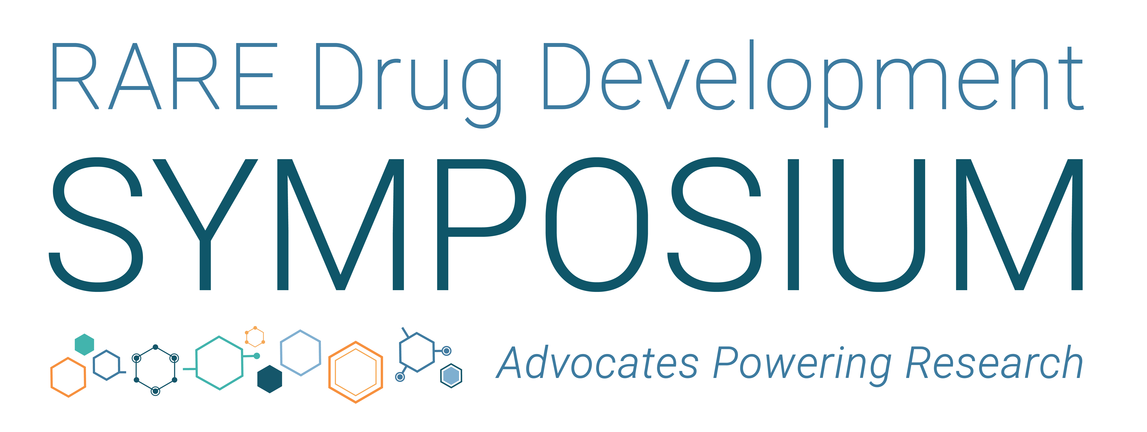
September 9 – 11, 2026 | Boston, Mass

Slide 2

Pitch Perfect
Building Industry Attraction and Strategic Asset Partnerships
#RDDS26

Slide 3
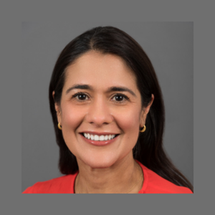
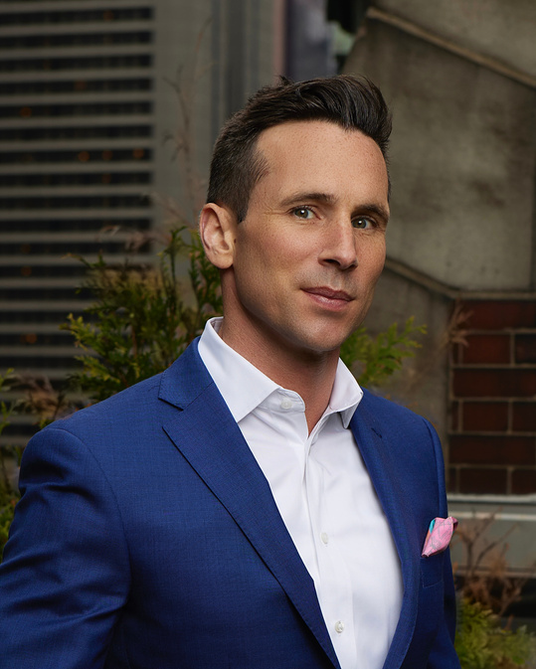
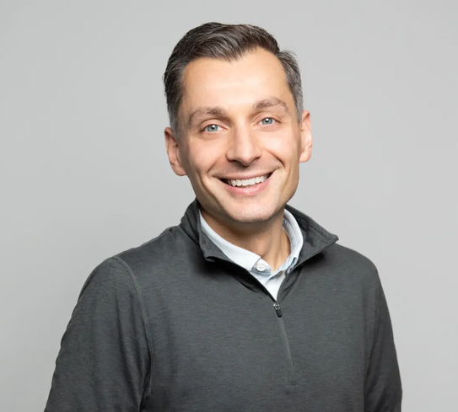
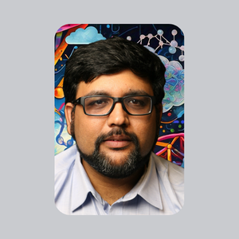
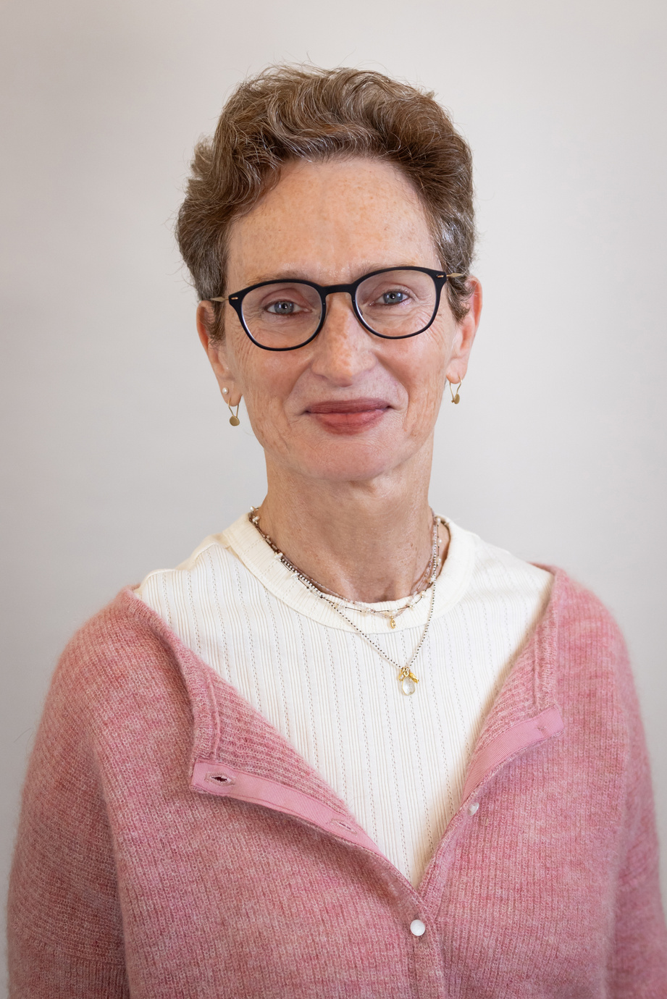
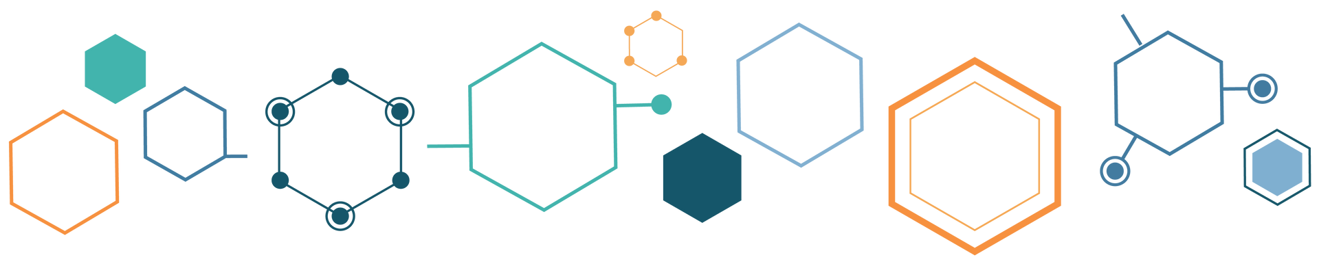
Our Judges
Maya Chopra
Boston Children’s Hospital
Michael Hund
EBRP & Rare Ventures
Walt Kowtoniuk, Ph.D.
Third Rock Ventures
Ankit Malhotra, Ph.D.
Amazon Web Services
Yael Weiss, M.D., Ph.D.
Mahzi Therapeutics

Slide 4
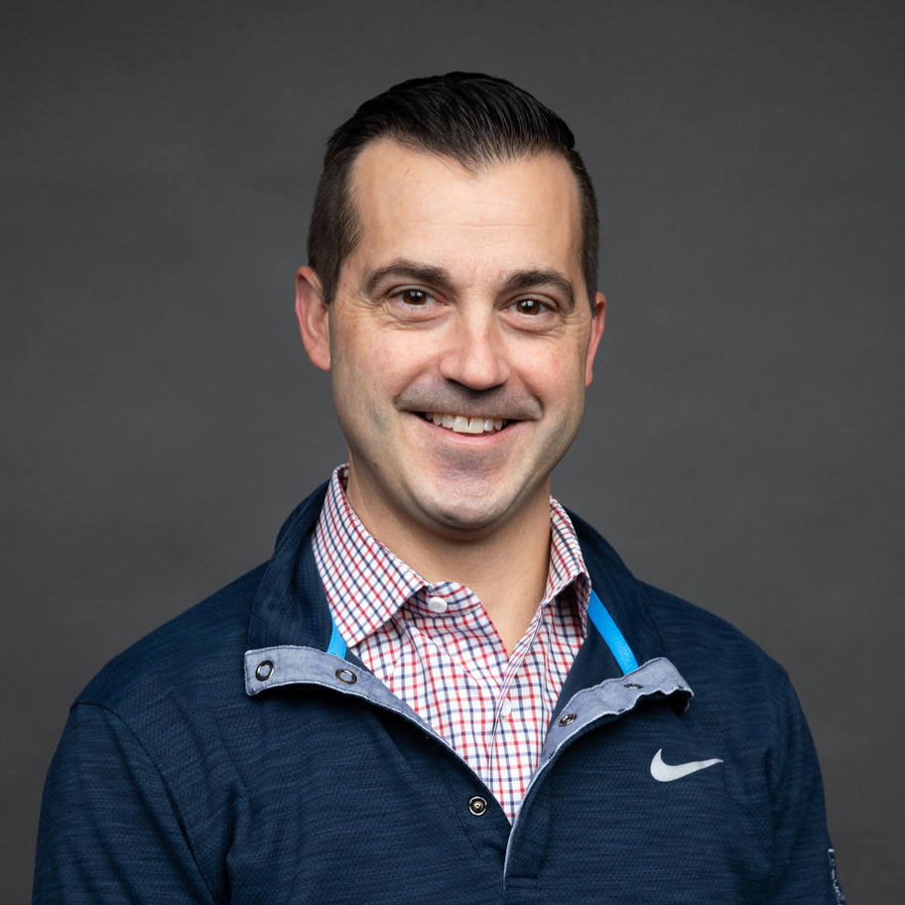
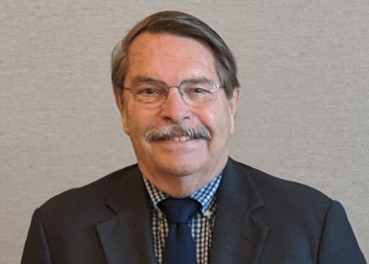

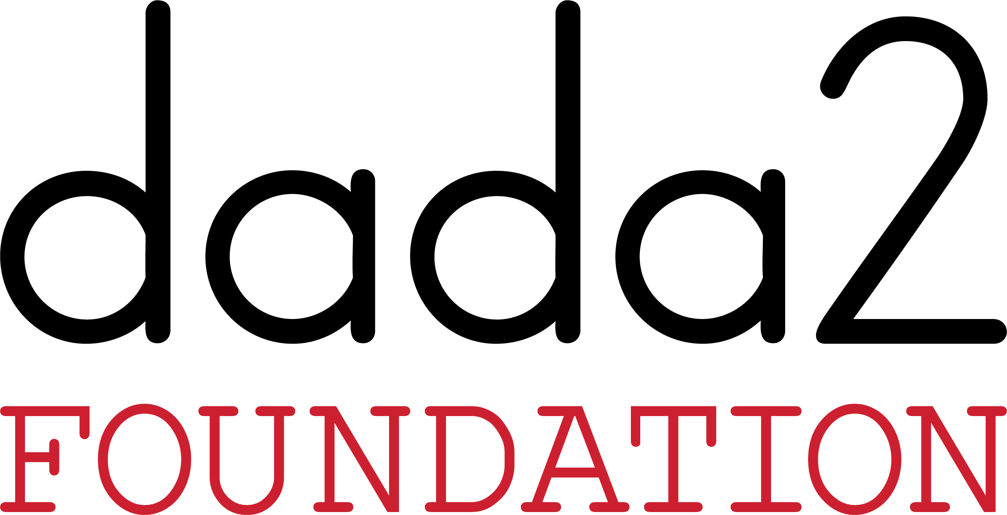
Our Patient Advocacy Groups
Jamas LaFreniere
Founder & President
Sophie’s Hope Foundation
Lex Cowsert
Chief Scientific Officer
DADA2 Foundation

Slide 5
Building Industry Attraction
Jamas LaFreniere
Founder & President
Sophie’s Hope Foundation

Slide 6



De-risking Glycogen Storage Disease 1b for Industry
GLOBAL GENES RDDS 2026 • TRACK 1: METABOLIC DISEASES
Sophie's Hope Foundation / cureGSD1b
Presented by: Jamas LaFreniere
Notes:
Hi Folks – Thank you for this amazing opportunity. I am Jamas LaFreniere, President and Founder of Sophie’s Hope Foundation and Cure GSD1b, and most importantly, I am Sophie’s dad, and as you can probably tell, she is the inspiration behind all the amazing work you will hear about today.
I will be speaking with you today about de-risking Glycogen Storage Disease1b for industry…and how what started as a single family fundraiser has grown into a coordinated research agenda with a partner-ready patient network.
To back up a little...
Back in 2020, just shy of Sophie’s 2nd birthday, she was diagnosed with GSD1b. After we finally confirmed her diagnosis, my wife and I were sent on our way with very little information, a weak plan, a pat on the back, and a "good luck." This simply was not good enough for us, and we made the decision that no other family should go through that same isolation and fear.
In six years, our foundation has turned GSD1b from a scattered set of case reports into a disease with a global registry, a coordinated research agenda, and ready-to-engage patient and academic networks.
Today I am here as a potential partner to show you how we've de-risked GSD1b so you can move faster and more efficiently.

Slide 7
THE PITCH
Why we are here
1
What you'll see
A biotech-ready case for GSD1b: the biology, the data infrastructure, and the patient population — de-risked and ready to move.
2
What we're asking
A development partner — gene/RNA therapy, small-molecule, or biologic — ready to bring a therapeutic engine to a mapped biology and a live registry.
3
What should convince you
Patients are enrolling soon in our prospective natural history study. The registry, biomarkers, and community are already moving — the only question is whether you help shape them now.
Sophie's Hope Foundation • cureGSD1b
2
Notes:
Here is what we will focus on today:
You will see that we are biotech-ready.
We are looking for a development partner.
We hope to impress you with the current state of GSD1b, especially our natural history study, which we will begin enrolling patients in very soon.
We have the registry, the biomarkers, and the community. It’s a very exciting time for GSD1b.

Slide 8
THE UNMET NEED
GSD1b: severe, systemic, and
without a disease-modifying therapy
1
Ultra-rare & genetic
Autosomal recessive metabolic liver disease from biallelic SLC37A4 mutations.
2
Lifelong, multi-system burden
Chronic hypoglycemia, hepatomegaly, nephromegaly, neutropenia and neutrophil dysfunction, recurrent infections, and inflammatory bowel disease.
3
Managed, not treated
Families rely on a demanding round-the-clock cornstarch diet and off-label SGLT2 inhibitors.
Sophie's Hope Foundation • cureGSD1b
3
Notes:
While we have made incredible progress, there is still a severe unmet need for this disease.
GSD1b is an ultra-rare metabolic genetic liver disease.
It presents with chronic and life threatening low blood sugar, and neutropenia…which often leads to severe infections and inflammatory bowel disease.
There are no FDA or EMA approved treatment. Patients rely on frequent, large doses of uncooked cornstarch around the clock, and the use of off-label SGLT2 inhibitors, like empaglifozin (aka Empa) to survive. In addition, patients must adhere to an extremely strict medical diet. This diet severely restricts all forms of glucose and limits carbohydrates in order to improve metabolic control and avoid glycogen accumulation in the liver and kidneys.
A missed dose, a common infection, or a simple feeding pump error can be fatal.

Slide 9
THE SIZE QUESTION
Ultra-rare — a strategic
asset, not a liability
GSD1b
Larger rare disease groups
N-of-1 / bespoke therapies
GSD1a (~1/125,000)
PKU (~1/10,000–15,000)
~1–2 in 1,000,000
Bespoke ASOs and
gene-editing programs
A platform, not just a program
Basket-trial ready
SLC37A4/G6PT shares a pathway with GSD1a's G6PC1, and the immune mechanism overlaps with other neutropenia syndromes.
Shared biomarkers with related ultra-rare cohorts open a path to a multi-indication basket trial — improving enrollment and power.
Small population, shared biology: GSD1b doesn't have to stand alone.
Sophie's Hope Foundation • cureGSD1b
4
Notes:
our population size has historically been a challenge in engaging with industry…..but the work we have done over the past several years, and changes in the industry have turned what used to be a deterrent into an opportunity.
GSD1b affects roughly one to two per million births — so smaller than GSD1a or PKU, but this is not an n-of-1 bespoke situation either. That distinction matters two ways:
First, the biology is shared, not siloed: GSD1b gene sits in the same pathway as GSD1a's, and the immune mechanism overlaps with other congenital neutropenia syndromes — meaning a therapy proven here can extend outward, and is not a dead-end.
Second, this is exactly the profile that basket-trial designs were built for: bundling related ultra-rare cohorts under one protocol to solve the numbers problem that makes sponsors nervous about single-indication ultra-rare programs.
We're not pitching a single-indication moonshot — we're offering a foothold into a broader mechanism with a trial-ready population and a clear path to scale.'

Slide 10
SCIENTIFIC READINESS
GSD1b biology is understood —
we've synthesized it for you
  A comprehensive, RTW-funded disease review covering genetics, biology, animal models, and prior therapeutic attempts.
Glucose-6-P
(cytosol)
SLC37A4
(G6PT)
G6Pase
(ER)
Metabolic
hypoglycemia • hepatomegaly
nephromegaly
  Clear therapeutic hypotheses already mapped: gene/RNA therapy, improved SGLT2 strategies, and novel fibrosis and immune targets.
Immune
neutropenia • infection • IBD
  You are not starting from zero. The biology is mapped, and mouse models show partial G6PT restoration normalizes metabolic features.
G6PT loss blocks glucose-6-phosphate transport into the ER, disrupting glucose and immune cell metabolism.
Sophie's Hope Foundation • cureGSD1b
5
Notes:
Some more positive news…The biology for GSD1b is well-characterized! We are absolutely not starting from zero.
We have a comprehensive disease review from the RTW Foundation.
We already have potential therapeutics mapped.
And…We have mouse models that show partial G6PT restoration that normalizes the metabolic features of this disease.

Slide 11
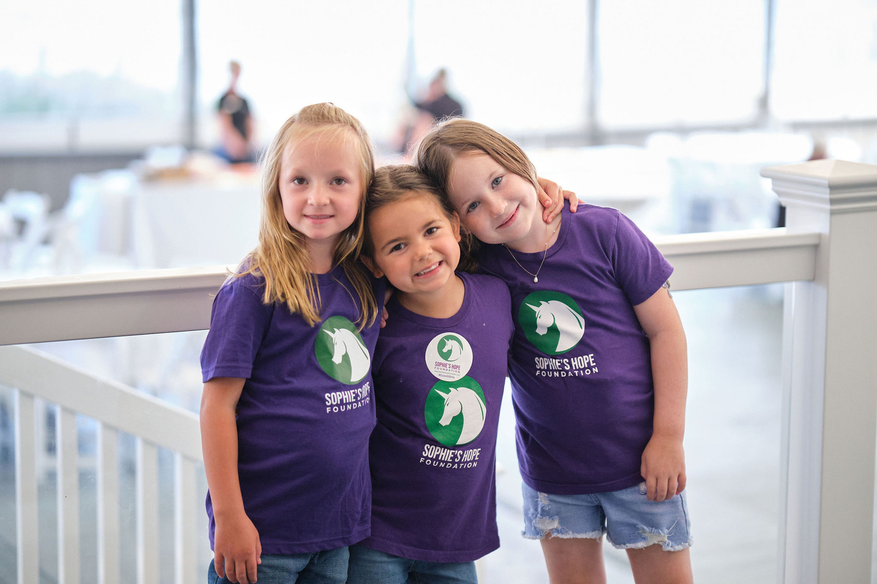
THE PATIENTS
Behind every data point is a patient and a family
The diagnosis
1
Most families spend months chasing a diagnosis while their child cycles through life-threatening hypoglycemic episodes.
The daily reality
2
Round-the-clock cornstarch feeds, glucose monitoring, and a life organized around a disease with no approved treatment.
What could change
3
A real therapy could mean a lifetime without night feeds, hospital stays, and fear of the next infection.
These are the families a therapy would reach and the community ready to help you get there.
Sophie's Hope Foundation • cureGSD1b
6
Notes:
But what does any of that mean and who are we doing this for? Behind the numbers, stats, and scientific terms there are real people struggling and suffering…
A diagnosis of GSD1b often leaves caregivers with little information, few clinicians who know the disease well, and more questions than answers. It means uncertainty, unpredictability, and a tight rope of metabolic control and infection prevention.
Life with this disease is grueling. We live our lives by the clock, waiting on the next alarm. Cornstarch doses are titrated to the gram and the timing to the minute. Patients and caregivers are always on alert for the next low blood sugar, the next illness. Sleep deprivation and the need for constant perfection in GSD1b are taken to a new level... missing a cornstarch dose could be the difference between life and death.
Pause and Show Cornstarch: This is a 24 hr snapshot of Sophie’s doses. 210 grams over 7 doses, around the clock every 3-4 hours. There is never a break.
A better therapy will be life-changing for patients and caregivers. It would mean a life without alarms (or at least a lot less), without repeated and severe infections, and a life without being tethered to a feeding pump or a hospital.

Slide 12
DE-RISKING, PART 1
Prospective Natural History Study
& Global Registry
Enrolling first patients this month — the window to help shape endpoints and biomarkers is open now, building directly on our Duke University retrospective natural history study.
Structured natural history dataset
Living, trial-ready patient registry
Community co-designed
Disease trajectories and outcomes, including GSD Value Project PROMs.
Generates the biomarkers and outcomes your trial will need.
Built with metabolic experts and the patient community.
Sophie's Hope Foundation • cureGSD1b
7
Notes:
Now lets shift the why to the how. let's talk about de-risking.
I think we can all agree that data is critical, but not just any random data. Well-thought-out and carefully collected data! That has been a focus of ours for many years.
We completed a retrospective natural history study at Duke University. The publication is under review and will be published soon.
We used that data to help develop our prospective natural history study and registry. This registry is both a structured natural history dataset AND a living, trial-ready patient registry. It is designed with input from experts and the patient community….and includes patient reported outcome measures that were created through our work with the GSD Value Project. The GSD Value Project is an amazing example of collaboration and a methodical approach.
Our Natural History Study and registry will generate the outcomes and biomarkers your trial will need.

Slide 13
DE-RISKING, PART 2
A data package that de-risks trial design
Clinical & metabolic
Immune & GI
Patient-centred
  Liver and kidney function
  Hypoglycemia history & growth
  Adenomas, nephropathy
  Labs and treatment history
  Neutrophil counts & function
  Infection burden
  IBD activity
  SGLT2 exposure/response
  Quality-of-life instruments
  Caregiver burden
  Hospitalizations
  PROs (GSD Value Project outcomes)
This is the external control arm you don't have to build alone.
Sophie's Hope Foundation • cureGSD1b
8
Notes:
Moving on to the data package this provides: This is the control arm you won't have to build alone.
As you can see, it includes both clinical and metabolic data-- covering the liver and kidneys, lab and treatment history.
It includes immune and GI data, It also includes neutropenia, infections, and IBD data and treatment responses to SGLT2 inhibitors (empa) that is used to address these issues.
The data package is also patient-centered. It includes quality-of-life instruments, caregiver burden measures, hospitalization data, and patient-reported outcome measures.

Slide 14
DE-RISKING, PART 3
Global reach and ready-to-go recruitment
Multi-site
Multi-year
Standardized
United States and expanding globally
Prospective design launched 2025
Matrix platform, EMR-integrated
Standardized data underpins:
Why this matters to you
  External control arms for interventional trials
  Endpoint exploration and validation
  Feasibility and statistical power calculations
A characterized, reachable, multi-site patient population means faster feasibility assessments and recruitment timelines than starting an ultra-rare program from scratch.
Sophie's Hope Foundation • cureGSD1b
9
Notes:
Our third de-risking measure is our global reach and network.
For the natural history study every site enrolls into the same standardized data model — the same variable definitions, same data collection standards — which is what makes this dataset usable as more than a description of natural history.
That consistency would let a sponsor build an external control arm, validate candidate endpoints, and run real feasibility and calculations against actual numbers instead of assumptions.
Of note, it's worth connecting this back to the size conversation from earlier: a standardized data model across GSD1b sites is also exactly the infrastructure a basket-trial design would need if GSD1b were bundled with related cohorts — so this isn't just supporting a single-indication program, it's laying groundwork that could support a broader trial strategy too.

Slide 15
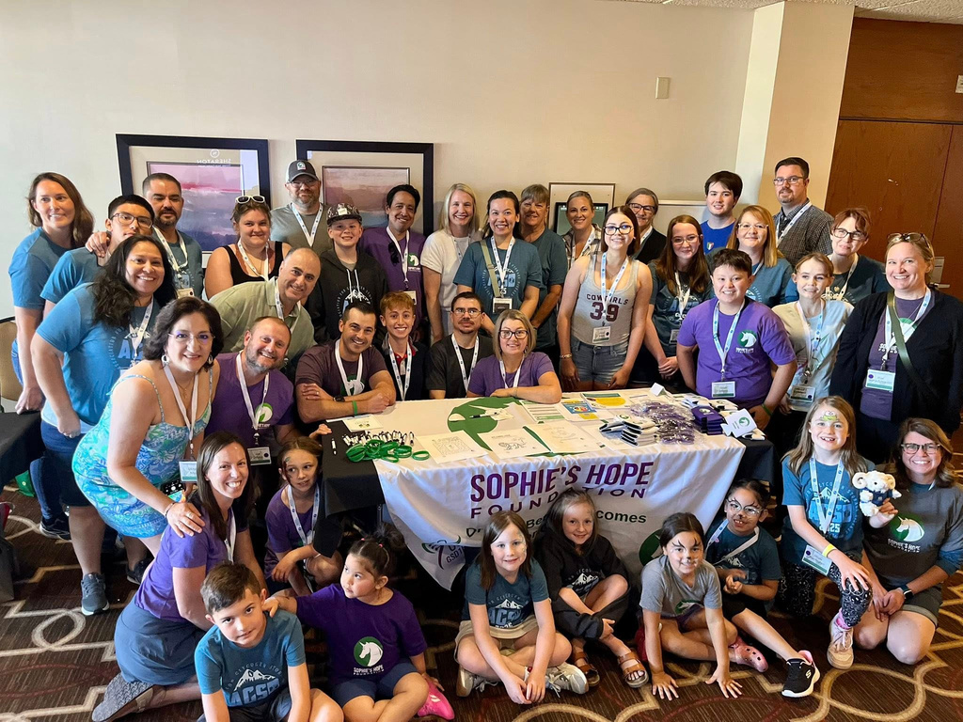
THE NETWORK
An engaged, organized global patient community
Active global community
1
Website, social channels, educational webinars, and family programs keep patients connected and informed.
Research-ready families
2
12
Families understand the research process and are motivated — including a 2022 FDA listening session.
Ongoing engagement
3
Fundraising and awareness campaigns keep the community active and visible.
We can help you recruit, retain, and co-design.
Sophie's Hope Foundation • cureGSD1b
10
Notes:
Let's talk a little more about the global network we have created: it matters because it helps us recruit and retain patients, as well as co-design.
We have over 250 patients registered on our patient contact registry, from over 50 countries and counting. We have established relationships with the largest GSD1b population centers globally.
Our patient community is very engaged through our mailing list, social media channels, and the educational programs we have established. They are educated and involved, including participating in an FDA listening session in 2022.
As our community has grown, so has patient and caregiver involvement. Our fundraising and awareness campaigns have consistently grown year over year.

Slide 16
FOR SPONSORS
De-risking development beyond the science
Faster feasibility & recruitment
Through a characterised, reachable global patient population, not a cold start.
Co-created trial materials
Family- and clinician-informed content that improves trial literacy, consent, and retention.
Early insight into what matters
Direct patient perspective on daily burden and quality of life — plus which PRO and biomarker endpoints are already validated.
Sophie's Hope Foundation • cureGSD1b
11
Notes:
SLOW DOWN HERE AGAIN.
We have talked about the data package and the community…….but what does it really mean for a potential partner?
It means faster feasibility and recruitment-- there is no cold start, we have the network for you.
Our informed trial materials mean better trial literacy, consent, and retention.
And early patient insight-- again this ties back to our patient reported outcomes- and biomarker-endpoint validation. This work is already underway.

Slide 17
RESEARCH INVESTMENT
Targeted research to close key gaps
1
Metabolic & immune biology
Mechanistic neutrophil work that informed the SGLT2-inhibitor repurposing strategy now used off-label.
M. Veiga-da-Cunha — UC Louvain
2
Liver gene therapy & kidney models
Preclinical gene-replacement programs and murine models of GSD1b nephropathy and fibrosis.
J. Chou — NIH
3
GSD1b mouse model program
A novel Slc37a4 exon-3 knockout mouse line (MMRRC #071623-JAX) for studying GSD1b biology and testing candidate therapies.
Jackson Lab & Brunetti-Pierri
Sophie's Hope Foundation • cureGSD1b
12
Notes:
As a research partner, we are invested.
We have funded over a half million dollars in research since 2020, and have another $1M+ committed over the next several years to projects that will directly benefit any potential industry partners.
Three examples of research directly relevant to partnering include:
First, we have supported Dr. Maria Veiga De Cunha for many years. She has been focused on neutropenia in GSD1b, which until recently was not very well understood. Her work directly informed the SGLT2-inhibitor repurposing (empa), which is now used off-label and is a core part of GSD1b care.
Second, Janice Chou’s gene-therapy and kidney-disease models—we did not fund this research, as it predates the foundation's existence, but it shows an active, engaged research community that we are very well connected to.
Lastly, we created a novel mouse model alongside Jackson Labs and Dr Brunetti-Pierri in Italy. This mouse model has enhanced and accelerated his work. The best part of that is this mouse model is now available to anyone in the world. This is a concrete and usable research tool already available.

Slide 18
RESEARCH INVESTMENT
A collaborative team waiting for partners
Collaborations spanning hepatology, nephrology, immunology, and gene therapy — groups in the US, Europe, and beyond generating translatable insight. We funded the 2023 GSD1b Empagliflozin International Consensus Meeting that led to use recommendations.
Advanced
therapy
Hepatology & metabolism
Nephrology
Immunology
  Translational precedent already established: groups actively enhancing SGLT2 inhibitor research, small molecule, and mRNA-therapy approaches in GSD1b.
  We know who is doing what: the RTW-funded disease review and our grants portfolio mean we can assemble the right advisory board quickly.
Sophie's Hope Foundation • cureGSD1b
13
Notes:
I want to point out that this research is not just one lab, it's a network spanning four disciplines. We have participated in research collaborations across the US, Europe and Asia, including fully funding the 2023 GSD1b Empagliflozin International Consensus Meeting, which led to use recommendations for off-label SGLT2 use.
Our work reflects the broader field's work in GSD1b, which we've tracked and synthesized.
What we bring to a partner is knowing who's doing what and where.
There is a translational precedent already established here with groups working on additional SGLT2 work, small molecule and mRNA therapy.
All of this means we can assemble the right team and advisory board quickly.

Slide 19
THE ASK
What we're looking for
If you're a company with...
We offer...
  Platform gene/RNA therapy for liver or metabolic pathways
  Small-molecule or biologic approaches to immune dysfunction, IBD, or fibrosis
  Experience in ultra-rare metabolic or immunometabolic indications
  Natural history data and registry access under appropriate data-sharing agreements
  Trial-ready sites and an engaged global patient community
  Scientific and patient-advisory input to shape a feasible program
GSD1b is well-mapped and the prospective Natural History Study is enrolling this month. The earlier you're involved, the more influence you have.
Sophie's Hope Foundation • cureGSD1b
14
Notes:
So lets wrap this up…
We are looking for industry partners to advance treatment for GSD1b. We have already done or have started much of the heavy lifting and are ready to play an active role in the next phase. GSD1b is ready:
GSD1b is well understood and characterized
Our retrospective natural history study is done
The prospective natural history study is ready to go and the time is now to make any changes or additions
We have a dedicated and motivated global network of clinicians and researchers.
And we have a motivated and well organized patient community.
The only missing piece for a brighter future for GSD1b is a therapeutic partner! Now is the time to join us!
THANK YOU!

Slide 20
Let's de-risk GSD1b — together
Biology mapped. NHS enrolling this month. Community ready. The only
missing piece is a therapeutic partner.
Sophie's Hope Foundation / cureGSD1b
Notes:
Thank you.

Slide 21
Strategic Asset Partnerships
Lex Cowsert
Chief Scientific Officer
DADA2 Foundation

Slide 22
PEG-ADA2: An Enzyme Replacement Therapeutic for DADA2
Lex Cowsert, Ph.D.
Chief Scientific Officer
Chip Chambers, M.D.
President and Founder
DADA2 Foundation

Slide 23



DADA2 The Broad Strokes
Deficiency of Adenosine Deaminase 2 (DADA2) is a rare autosomal recessive disease caused by mutations in the ADA2 gene for which there are no approved therapies.
Patient Population
Disease Burden
36,000 Patients worldwide
34M Carriers worldwide
1.5M carriers may benefit
Age of onset:
24% <1year
76% <10 years
Occasional adult onset
Morbidity: 51% develop strokes, 50% hematologic dysfunction/BMF; 30% immunodeficiency.
Mortality: 8% to 30% by age 30.
Lifelong, escalating dependence on medical, social, government, and family support networks as progressive disease steadily erodes independence, function, and quality of life.
Notes:
A base population of approximately 36,000 patients. With approximately 600 new DADA2 patients and an estimated 30,000 eligible carriers born per year.
Depending upon the specific mutation, DADA2 carriers can be symptomatic due to reduced ADA2 blood enzyme levels. Examples of other autosomal recessive genetic diseases where carriers are symptomatic include Sickle cell disease, Beta-thalassemia, alpha- thalassemia, Cystic fibrosis, Familial Mediterranean Fever and others…... Therefore, a subset of DADA2 carriers represents an expanded urgent unmet need and market.
Stroke is often the first symptom and the average age of first stroke is approximately 6 years old.

Slide 24
DADA2 Clinical Phenotypes and Overlapping Symptoms
Early onset stroke
Livedo racemosa/reticularis
Cutaneous vasculitis & nodules
Digital necrosis & gangrene
PAN-like vasculitis
Cranial & peripheral neuropathies
Arterial aneurysms (GI, renal, brain)
Bowel perforation
Renal infarction & hypertension
Myalgia, arthralgia, arthritis
Inflammatory/Vasculitic
The clinical presentation of DADA2 is extremely complex
DADA2 has three primary clinical presentations
The DADA2 Foundation estimates that DADA2 has at least 132 symptoms
Some symptoms are restricted to one phenotypes, other are found in multiple phenotypes
Immunodeficiency
Recurrent fevers
GI inflammation
SLE-like autoimmunity
Hematologic
Anemia
Immune-mediated cytopenia
Splenomegaly/hepatosplenomegaly
Constitutional symptoms (fatigue, failure to thrive, chronic inflammation
Pure Red Cell Aplasia
Severe transfusion-dependent anemia
Thrombocytopenia & bleeding risks
Pancytopenia
Bone marrow failure/hypoplasia
T-cell Large Granular Lymphocytic infiltration
Hypogammaglobulinemia
Decreased class-switch memory B cells
Recurrent/opportunistic infections
Impaired antibody vaccine response
Autoimmune features
Benign lymphoid hyperplasia
Type 1 interferon signature
Lymphoproliferative/lymphoma
Lymphopenia
Neutropenia
Bone marrow lymphoid aggregates
LEGEND:
Specific to phenotype
Occurs in multiple phenotypes
Notes:
DADA2 has a complex clinical presentation, including three primary phenotypes: inflammatory/vasculitic, hematologic, and immunodeficiency. In addition, there are an estimated 132 symptoms, some of which are restricted to one clinical phenotype, while other can present across multiple clinical phenotypes..

Slide 25




One Disease, Three Faces and No Treatment That Works For All
Inflammatory/
Vasculitic
Hematological/
Bone Marrow Failure
Immuno-
deficiency
TNF inhibitors
PARTIAL RELIEF
TNF inhibitors
NOT EFFECTIVE
TNF inhibitors
NOT EFFECTIVE
The only proven therapy for this phenotype. TNF inhibitors are effective at reducing stroke but have only modest effects on its other symptoms.
Do not work against bone marrow failure.
Do not work against immunodeficiency.
Bone marrow transplant
OUT OF REACH
IVIG + antibiotics
SHORT-TERM ONLY
No therapy addresses the full spectrum of inflammation.
Curative — but limited by the search for a compatible donor and the risks and complexity of transplant itself.
Can manage infections day to day — but are not suitable as long-term treatments.
The phenotypes overlap. Most patients can be classified by their primary symptoms; however, most patients also show symptoms of one or both of the other phenotypes, further complicating treatment.
THE PROMISE AHEAD
By restoring the missing ADA2 enzyme, ADA2-ERT targets the fundamental defect of DADA2 holding the promise of treating all three phenotypes at once.
✓ Vasculitis & inflammation
✓ Bone marrow failure
✓ Immunodeficiency
ADA2 Enzyme Replacement Therapy
Notes:
Three clinical phenotypes: Vasculitic/Inflammatory, Bone Marrow Failure, Immunodeficiency.
TNF inhibitors are highly effective for treating DADA2 inflammatory/vasculitic disease. However, as in other inflammatory diseases such as Crohn's disease and arthritis, patients may over time develop resistance, necessitating a product change.
Bone marrow transplantation has been shown to be highly effective and even curative; however, it comes with many challenges, including finding suitable donors.
There are no effective therapies for DADA2 Immunodeficiency only supportive therapies such as IVIG and antibiotics.

Slide 26
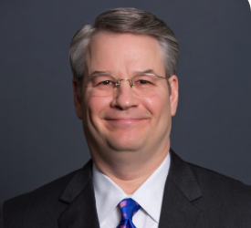
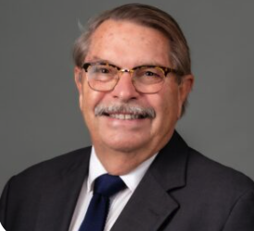
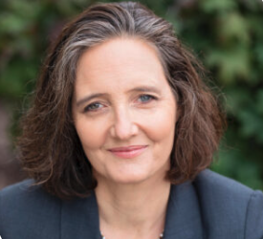
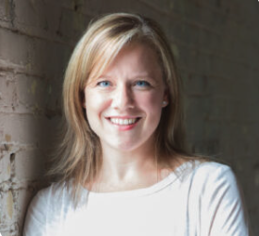
The DADA2 Foundation
Chip Chambers, MD
Founder & President
Lex Cowsert, Ph.D.
Chief Scientific Officer
Mary Makley
Executive Director
Kristen Hayner, M.Ed.
Director Communication & Strategic Initiatives
Founded 2016 by Chip Chambers, M.D.
Four international conferences
Built a Global Clinical Research Network of DADA2 experts that have collectively published 20% of the total DADA2 scientific literature
Consult on diagnosis, management, and referral of DADA2 patients around the world
With 38 physicians, researchers, patients, and care givers, the DADA2 Foundation published an international consensus paper that set the standard of diagnosis and management of DADA2
Provide support and community for DADA2 patients around the world
Building a patient registry
Acquired and repurposing a shelved ADA2 enzyme replacement therapeutic for DADA2
Developing an NIH-funded real-time, point-of-care, medical device for the diagnosis of DADA2
With its strong medical and drug development expertise, the DADA2 Foundation is well equipped to lead a drug repurposing program
Notes:
We are unique in the patient advocacy universe because we were founded and led by a physician with children with DADA2 coupled with strong drug development and rare disease expertise on staff.

Slide 27
DADA2 Foundation’s Global Clinical Research Network
Ready for Proof-of-Concept and Clinical Development
National Institutes of Health
Bethesda, MD
Site of discovery of DADA2. Long standing DADA2 cohort.
60 patients
Boston Children’s Hospital
Boston, MA USA
Pediatric rheumatology and immunology with a long-standing DADA2 cohort and published experience with allogeneic haematopoietic cell transplantation in DADA2.
14 patients. 152 patients across international collaborations
Great Ormond Street Hospital
London, UK
Pediatric rheumatology alongside the Department of Pediatric Immunology and Gene Therapy with an established DADA2 cohort.
15 patients
IRCCS Ospedale San Raffaele
Milan, Italy
Pediatric rheumatology and immunology with an established DADA2 cohort.
18 patients
WHAT THE NETWORK DELIVERS
Clinical Expertise
The DADA2 Global Research Network is comprised of the leading clinical and research expertise who have collectively authored 20% of the peer reviewed DADA2 scientific literature.
Aligned biospecimens
Harmonized sample collection supports ADA2 enzyme-activity assays, biomarker work and endpoint qualification.
Trial-ready sites
Established DADA2 cohorts and pediatric expertise positioned to open first-in-human PEG-ADA2 study.
Notes:
All our academic collaborators are conducting cutting edge clinically relevant research and experienced drug developers.
Preliminary discussions with the NIH about a Clinical Trial Cooperative Research and Development Agreement or CT-CRADA.

Slide 28
What is PEG-ADA2?
PEG-ADA2 is a modified version of the human ADA2 enzyme.
Multiple genetic variants that increases enzymatic activity and circulation half-life which translates to less frequent administration and lower doses.
Pegylation increases stability and circulation half-life.
Like other pegylated enzyme replacement therapeutics, our Target Product Profile envisions biweekly or monthly patient administered subcutaneous injections.
The Foundation has royalty-free ownership of PEG-ADA2 including 31 patents on compositions and use.
Notes:
As we stated earlier, DADA2 is caused by the loss of ADA2 enzyme activity in the body. Rather than trying to intervene therapeutically downstream, the goal here is to address the primary metabolic defect with enzyme replacement therapy.

Slide 29



PEG-ADA2 THERAPEUTIC HYPOTHESIS
ADA2 Replacement Rescues Every Hallmark Symptom of DADA2 Across All Clinical Phenotypes
THE DISEASE STATE
THE HYPOTHESIS
Mutant ADA2 disrupts normal signaling
PEG-ADA2 ERT normalizes the same pathways
Mutant ADA2
PEG-ADA2
Biallelic loss-of-function variants leave patients without functional ADA2 enzyme activity
Pegylated recombinant ADA2 restores circulating enzyme activity correcting the fundamental defect
Inflammatory & vasculitic pathways
DYSREGULATED
Inflammatory & vasculitic pathways
NORMALIZED
Unchecked inflammatory signaling drives systemic inflammation, vessel wall injury and vasculitis — including stroke.
Restored regulation of inflammatory signaling calms systemic inflammation and protects the vessel wall.
Bone marrow development & function
IMPAIRED
Bone marrow function
RESTORED
Hematopoiesis is disrupted, producing cytopenias, red cell aplasia and progressive marrow failure.
Hematopoiesis recovers, with restored marrow output across the affected blood cell lineages.
B cell maturation & function
BLOCKED
B cell maturation & differentiation
RESTORED
B cells fail to mature, leaving few memory B cells, low antibody levels and recurrent infection.
B cells mature and differentiate normally, rebuilding memory B cell populations and antibody production.
Proposed mechanism. By correcting the underlying enzyme deficiency rather than a single downstream pathway, ADA2 enzyme replacement therapy is hypothesized to address all three clinical phenotypes of DADA2.
Notes:
Of course, at the top of the list is that DADA2 is an enzyme deficiency and like many other enzyme deficiencies, DADA2 can be treated by enzyme replacement.
ADA2 replacement has been evaluated in systems modeling each of the DADA2 clinical phenotypes DADA2 and has been shown to be beneficial.
These data are extracted and summarized from multiple publications from the DADA2 Foundation’s SAB and Global Clinical Research Network.

Slide 30
PEG-ADA2 SCIENTIFIC RATIONALE PHARMACOLOGY
ADA2 Replacement Rescues Every Hallmark of DADA2 Across All Clinical Phenotypes
Delivery Technology | Clinical Hallmark | Clinical Phenotype | Outcome
PEG-ADA2 | Macrophage M1 polarization | IF | Normalized in mice
rADA2 | Hematopoietic stem/progenitor (HSPC) dysfunction | H | Rescued in ADA2-KO zebrafish
 | Bone marrow & immune progenitor dysfunction | BMF | Rescued in ADA2-KO zebrafish
 | HSPC emergence & differentiation defects | BMF | Rescued in ADA2-KO zebrafish
 | Neutropenia | H | Rescued in ADA2-KO zebrafish
ADA2 Gene Therapy | Macrophage M1 polarization | IF | Rescued in patient cells
 | Hematopoietic stem/progenitor (HSPC) dysfunction | H | Rescued in patient cells
 | Endothelial cell inflammation | IF/Stroke | Rescued in patient cells
Clinical phenotype key: IF = inflammatory / vasculitis • H = hematologic • BMF = bone marrow failure
Notes:
Of course, at the top of the list is that DADA2 is an enzyme deficiency and like many other enzyme deficiencies, DADA2 can be treated by enzyme replacement.
ADA2 replacement has been evaluated in systems modeling each of the DADA2 clinical phenotypes DADA2 and has been shown to be beneficial.
These data are extracted and summarized from multiple publications from the DADA2 Foundation’s SAB and Global Clinical Research Network.

Slide 31
PEG-ADA2 Has Proven Safe in All Systems Tested So Far
PEG-ADA2 SCIENTIFIC RATIONALE SAFETY
Chronic treatment with PEG-ADA2 did not cause overt toxicity in mice.
Transplantation of LV-ADA2 transduced healthy donor HSC into NBSGW mice has no adverse impact on body weight or tissue histology.
Over expression of ADA2 in HSC for either healthy individuals or DADA2 patients does not have toxic side effects in vitro or in vivo.
ADA2 overexpression does not impair in vivo engraftment or multilineage output of CD34+ cells from healthy donors or DADA2 patients.
Notes:
While PEG-ADA2 has not yet been rigorously evaluated in standard toxicology testing a series of studies using multiple delivery systems in multiple models of DADA2 clinical phenotypes have been promising.
These data are extracted and summarized from multiple publications from the DADA2 Foundation’s SAB and Global Clinical Research Network.

Slide 32
Proof-of-Concept Plan
The DADA2 Foundation has developed a proof-of-concept program to deliver the following:
Demonstrate the potential of PEG-ADA2 as a safe and effective therapeutic for treatment across all three clinical phenotypes of DADA2.
Identify and validate the initial phenotype for clinical trial.
Identify and validate clinical trial inclusion and exclusion criteria.
Identify and validate biomarkers and clinical trial endpoints.
Derisk future investment in the continued development of PEG-ADA2.
Increase value of the asset.
We plan to conduct most of the experiments in DADA2 patient cells which will improve the translation from bench to clinic.
Notes:
Add bullet point to suggest we will conduct preclinical development plan with CRO.

Slide 33
Competitive Landscape
A comprehensive search across the pharma/biotech industry by Explority AI and other resources did not reveal any companies with a publicly listed DADA2 therapeutic pipeline as of September 1, 2026.
Two European academic groups with advanced preclinical retroviral-based ADA2 gene therapy programs for DADA2.
The competitive risk seems low and the path to first to market clear.

Slide 34
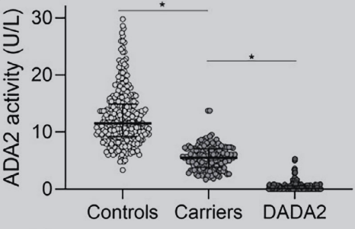
DADA2 Clinical Phenotypes and Overlapping Symptoms
Early onset stroke
Livedo racemosa/reticularis
Cutaneous vasculitis & nodules
Digital necrosis & gangrene
PAN-like vasculitis
Cranial & peripheral neuropathies
Arterial aneurysms (GI, renal, brain)
Bowel perforation
Renal infarction & hypertension
Myalgia, arthralgia, arthritis
The clinical presentation of DADA2 is extremely complex
DADA2 has three primary clinical presentations
The DADA2 Foundation estimates that DADA2 has at least 132 symptoms
Some symptoms are restricted to one phenotypes, other are found in multiple phenotypes
One biomarker, reduced or absent ADA2 blood enzyme level, is share by all phenotypes
Inflammatory/Vasculitic
Immunodeficiency
Recurrent fevers
GI inflammation
SLE-like autoimmunity
Hematologic
Anemia
Immune-mediated cytopenia
Splenomegaly/hepatosplenomegaly
Constitutional symptoms (fatigue, failure to thrive, chronic inflammation
Pure Red Cell Aplasia
Severe transfusion-dependent anemia
Thrombocytopenia & bleeding risks
Pancytopenia
Bone marrow failure/hypoplasia
T-cell Large Granular Lymphocytic infiltration
Hypogammaglobulinemia
Decreased class-switch memory B cells
Recurrent/opportunistic infections
Impaired antibody vaccine response
Autoimmune features
Benign lymphoid hyperplasia
Type 1 interferon signature
Lymphoproliferative/lymphoma
Lymphopenia
Neutropenia
Bone marrow lymphoid aggregates
LEGEND:
Specific to phenotype
Occurs in multiple phenotypes
Yue, J et al. 2026 Arthritis & Rheumatology
Notes:
DADA2 has a complex clinical presentation, including three primary phenotypes: inflammatory/vasculitic, hematologic, and immunodeficiency. In addition, there are an estimated 132 symptoms, some of which are restricted to one clinical phenotype, while other can present across multiple clinical phenotypes..

Slide 35
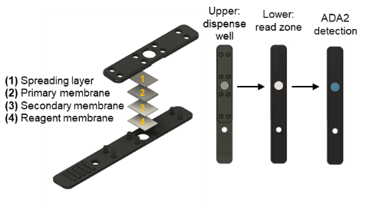
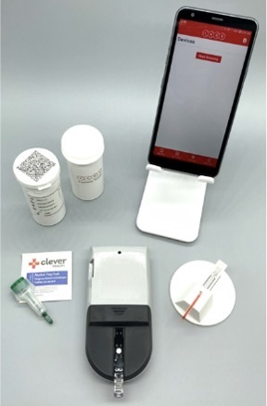
ADA2-Now Point-of-Care Realtime Diagnosis
ADA2 NOW
DADA2
Foundation
Completed SBIR Phase 1 development
Working prototype
Can deliver results in the clinic in 10 minutes
Preparing an SBIR Phase II application to support clinical development
ADA2 NOW
DADA2
Foundation
ADA2-Now + PEG-ADA2 imagine a world where a patient can walk into a doctor’s office, get diagnosed in 10 minutes and walk out with a prescription to treat their rare disease.
The DADA2 Foundation estimates that only about 5% of DADA2 patients are diagnosed. That means 95% of DADA2 patients are undiagnosed and untreated or being treated with inappropriate drugs that are ineffective, may carry significant risks and significant financial burden, while their disease continues to progress. Imagin a world where a patient can walk into a doctor's office, be given at test, get the results in 10 minutes and walk out with a prescription for their rare disease.

Slide 36
The Ask
The DADA2 Foundation has developed a proof-of-concept plan that lays the foundation for and derisks PEG-ADA2 preclinical and clinical development programs.
The proof-of-concept plan will be executed through academic labs with DADA2 expertise, biobanks, publication track records in the methods used, and clinical trial experience.
The proof-of-concept plan will take 12-18 months, with an estimated budget of $900K.
We are seeking funding through a pharma partnership or direct investment through medical venture philanthropy.

Slide 37
Thank You
Imagine a future where a DADA2 patient can be diagnosed in a single office visit and receive a life changing medicine the same day.
DADA2 Foundation
For more information Contact
Lex M. Cowsert, Ph.D.
Chief Scientific Officer
DADA2 Foundation
lex.Cowsert@dada2.org
+1 (323) 835-1960

Slide 38
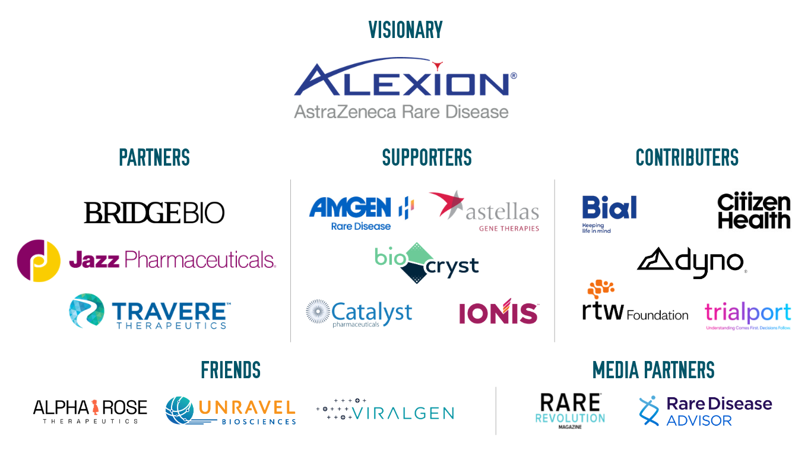
Thank you to our Sponsors!
#RDDS26

Slide 39
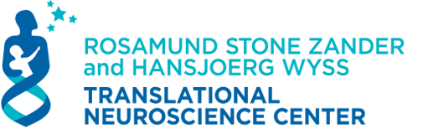

The 2026 RARE Drug Development Symposium is grateful to our valued Collaborators:
At Boston Children’s Hospital
#RDDS26

