Slide 1

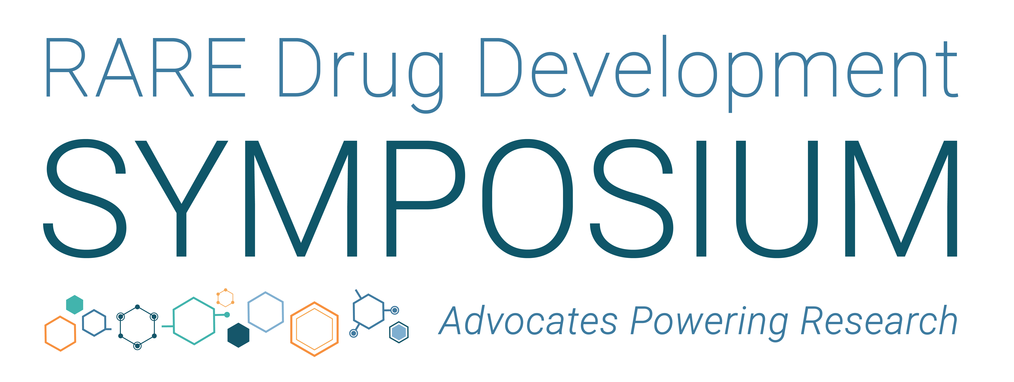
September 9 – 11, 2026 | Boston, Mass

Slide 2

Therapeutic Timeline
Deep Dive:
Synergies & Handoffs
that Matter Most
#RDDS26

Slide 3
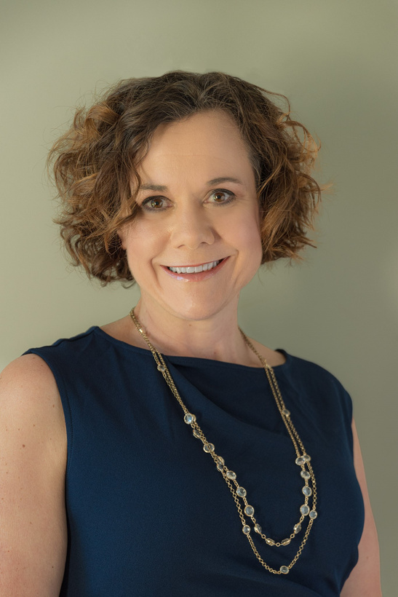
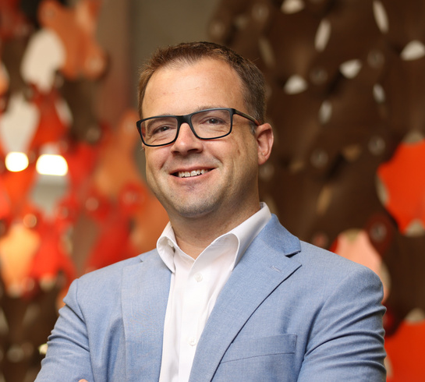
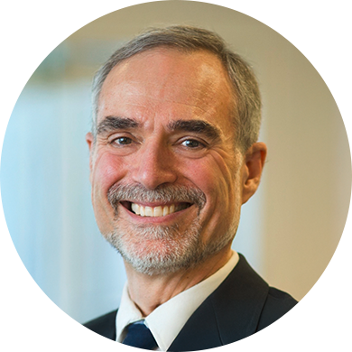
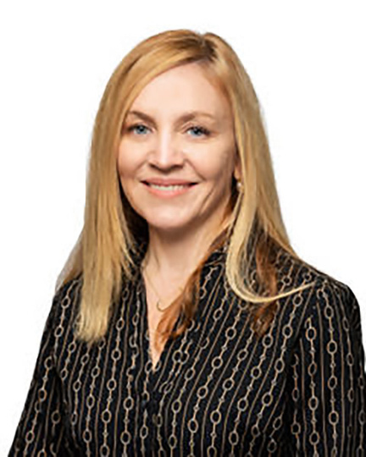
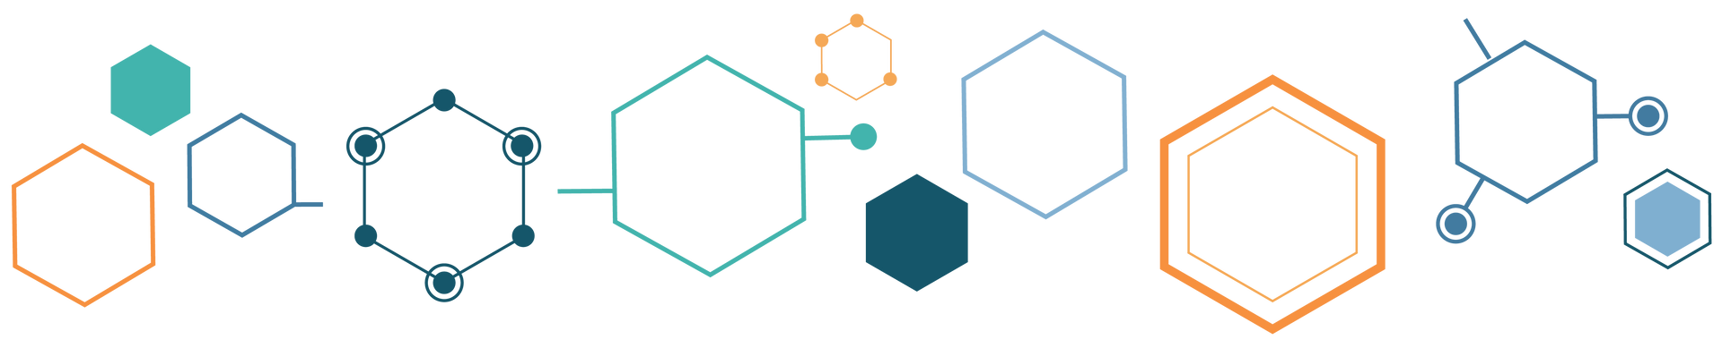
Therapeutic Timeline Deep Dive
Jill Weimer, Ph.D.
Sanford Research
Sean Kassen, Ph.D.
Ara Parseghian Medical Research Fund
Marc Patterson, M.D.
IntraBio
Jennifer Panagoulias
Foundation for Angelman Syndrome Therapeutics (FAST)

Slide 4
Niemann-Pick disease, type C - basics
Atypical LSD - trafficking defect, not enzyme deficiency
Autosomal recessive – 2 genes (NPC1- 95%; NPC2-5%)
Sphingosine storage >> Depleted lysosomal calcium
>> Impaired endosomal-lysosomal-ER-mitochondrial trafficking
>> Excess (lipid) substrate storage in periphery and brain
>> Multiple downstream pathologies (impaired autophagy, mt dysfunction, neuroinflammation)
Characteristic LM and EM neuropathology
Ultra-rare: birth incidence ~ 1/100,000/year; panethnic
Protean clinical manifestations (VSGP, ataxia, dysphagia, dysarthria, dystonia, dementia, seizures, psychosis)
Progressive neurodegeneration and early death

Slide 5
Niemann-Pick disease type C milestones, 1914–2024
Scientific discovery and diagnosis
Pathology, cellular mechanism, gene discovery, controlled trials and the first approved therapies
Therapeutic development
1914
Niemann's original description
First reported case of ASMD
1935
Klenk identifies sphingomyelin
ASMD defined as a sphingomyelin lipidosis
1961
Crocker classification
Niemann-Pick groups A to D
1979
npcNIH mouse described
Pentchev - spontaneous murine model
1984
Cholesterol trafficking defect
Pentchev - filipin staining and esterification assays
1993
Cholesterol-lowering drugs
Patterson et al - first therapeutic trial
1996
Cyclodextrin depletes cholesterol
Neufeld et al - HPβCD at the plasma membrane
2000
NPC2 cloned
Naureckiene et al
1920s
Pick's pathological studies
Defines the pathology of ASMD
1958
Crocker and Farber
ASMD conflated with NPC
1966
Brady defines the enzyme defect
Acid sphingomyelinase deficiency in NPA and NPB
1980
Dual enzyme deficiency
Pentchev - glucocerebrosidase and sphingomyelinase
1990
Feline model of NPC
Lowenthal et al
1996
Elevated oxysterols
Pentchev
1997
NPC1 cloned
Carstea et al
2000
Abnormal retroendocytosis
Pentchev
2001
Miglustat in npcNIH mice
Zervas et al - NB-DNJ
2007
Pivotal miglustat trial
Patterson et al - first trial in human NPC
2011
Oxysterols for diagnosis
Jiang et al - plasma biomarker
2014
Intraventricular cyclodextrin
Matsuo et al - ICV HPβCD
2015
Intracisternal cyclodextrin
Vite et al - feline NPC
2017
Intrathecal cyclodextrin
Ory et al - open-label phase 1-2 trial
2021
Arimoclomol trial
Mengel et al - randomised, placebo controlled
2024
MIPLYFFA approved
Arimoclomol with miglustat, September
2004
Allopregnanolone in npcNIH mice
Griffin et al
2009
Cyclodextrin is the active agent
Davidson et al; Liu et al
2011
HDAC inhibition
Pipalia et al - in NPC fibroblasts
2015
Acetyl-DL-leucine in NPC
Bremova-Ertl et al
2016
Heat shock protein therapy
Kirkegaard et al
2020
Long-term miglustat outcome
Patterson et al
2024
NALL trial
Bremova-Ertl et al - randomised, double blind
2024
AQNEURSA approved
Levacetylleucine (NALL), September
Markers are evenly spaced by sequence, not by elapsed time; the upper band runs 1914–2000 and the lower band continues 2001–2024. ASMD = acid sphingomyelinase deficiency (Niemann-Pick types A and B); NPC = Niemann-Pick disease type C; HPβCD = 2-hydroxypropyl-β-cyclodextrin; NB-DNJ = N-butyldeoxynojirimycin (miglustat); npcNIH = spontaneous NPC mouse model; ICV = intracerebroventricular; NALL = N-acetyl-L-leucine (levacetylleucine). Both 2024 approvals shown are US FDA approvals.
Notes:
Foundations of the field. Niemann's 1914 case and Pick's pathological studies of the 1920s described what is now called ASMD. Crocker and Farber's 1958 series conflated ASMD with NPC; Crocker's 1961 groups A to D first separated them descriptively. Brady's 1966 work defined the acid sphingomyelinase defect in types A and B, leaving NPC biochemically unexplained until Pentchev's npcNIH mouse in 1979.
Three decades in which NPC became a defined cell-biological disease. Pentchev's cholesterol trafficking defect (1984) gave the field its diagnostic assays - filipin staining and cholesterol esterification. NPC1 was cloned in 1997 and NPC2 in 2000. Therapeutic work moved from cholesterol-lowering drugs (1993) through miglustat in the mouse (2001) to the pivotal human trial (2007), while the 2009 reanalysis of the allopregnanolone studies identified cyclodextrin as the active agent.
The modern era. Plasma oxysterols (2011) made biochemical screening practical. Cyclodextrin was delivered by every route - intraventricular, intracisternal and intrathecal - and randomised controlled trials of arimoclomol (2021) and N-acetyl-L-leucine (2024) led to the first two NPC-specific approvals in September 2024: MIPLYFFA (arimoclomol, in combination with miglustat) and AQNEURSA (levacetylleucine).

Slide 6

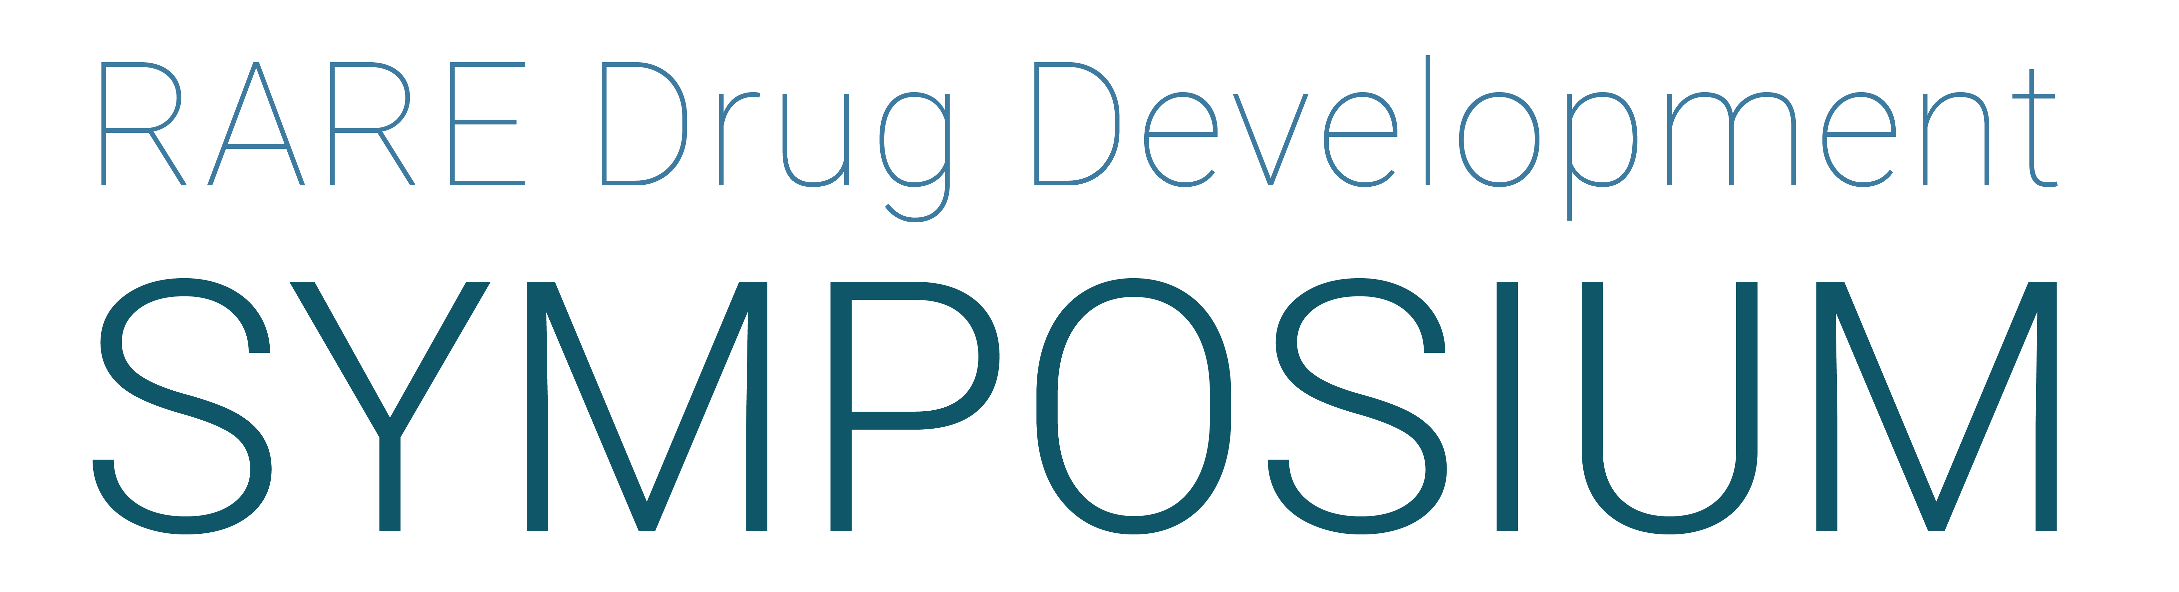

Slide 7






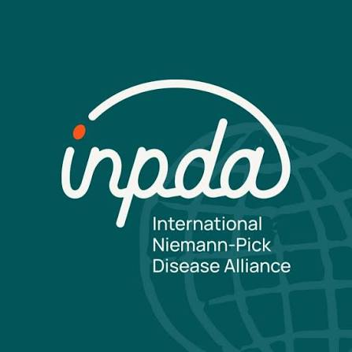
Hope For Hayley
Jonathan’s Dreams

Slide 8
NPC COMMUNITY & RESEARCH JOURNEY
BLUE = FOUNDATION / CHALLENGES GREEN = COMMUNITY / PROGRAM MILESTONES
Niemann-Pick Type C: a longitudinal timeline
From the Parseghian Foundation to today’s clinical and biomarker ecosystem
FOUNDATION / CHALLENGES
1994
2016
2018
Jan 2021
Jun 2021
Fall 2021
• Michael, Marcia & Christa Parseghian diagnosed with NPC
• Parseghian Medical Research Foundation established in Tucson
• Research grants • Annual conference • Marketing
They made many advancements
Lost Michael, Marcia and Christa
Foundation merged with Notre Dame → Parseghian Fund
Sean Kassen becomes director
Challenges: fractured community; 85 conference attendees; 7 active grants; $900K raised; Miglustat rejected in U.S.; 3 clinical trials enrolling; NNPDF had no director
Adrabetadex trial failed
Mallinckrodt ended Adrabetadex EAP;
FDA would not allow new patients because of safety issues
Orphazyme received a complete response letter for Arimoclomol
FDA required improvement of the NPC Clinical Severity Scale (NPC-CSS)
1994
2013
2016
2018
2019
2021
2022
2024
2026
Throughline: the field moved from foundation-building and fragmented development toward a coordinated ecosystem of registry, screening, biomarkers, regulation and clinical trials.
1

Slide 9
NPC COMMUNITY & RESEARCH JOURNEY
BLUE = FOUNDATION / CHALLENGES GREEN = COMMUNITY / PROGRAM MILESTONES
Niemann-Pick Type C: a longitudinal timeline
From the Parseghian Foundation to today’s clinical and biomarker ecosystem
FOUNDATION / CHALLENGES
1994
2016
2018
Jan 2021
Jun 2021
Fall 2021
• Michael, Marcia & Christa Parseghian diagnosed with NPC
• Parseghian Medical Research Foundation established in Tucson
• Research grants • Annual conference • Marketing
They made many advancements
Lost Michael, Marcia and Christa
Foundation merged with Notre Dame → Parseghian Fund
Sean Kassen becomes director
Challenges: fractured community; 85 conference attendees; 7 active grants; $900K raised; Miglustat rejected in U.S.; 3 clinical trials enrolling; NNPDF had no director
Adrabetadex trial failed
Mallinckrodt ended Adrabetadex EAP;
FDA would not allow new patients because of safety issues
Orphazyme received a complete response letter for Arimoclomol
FDA required improvement of the NPC Clinical Severity Scale (NPC-CSS)
1994
2013
2016
2018
2019
2021
2022
2024
2026
COMMUNITY / PROGRAM MILESTONES
2013
2018
2019
2021
2022
2024
2026
International Niemann-Pick Disease Registry wsa launched
Launched a newborn screen
NPC community hosted a PFDD with FDA
Launched initiative to improve NPC-CSS
Mandos (now Beren) acquired Adrabetadex
Biomarker program launched
Zevra acquired Arimoclomol
Intrabio launched a Phase 3 trial for Aquneursa
Adrabetadex EAP reopened
Miplyffa (arimoclomol) approved with Miglustat
Aquneursa
Beren submitted NDA for Adrabetadex
Conference had 190 attendees
Raise over $4 mill/year
Fund 18 active grants and initiatives
Support the Next Generation of Therapies
Throughline: the field moved from foundation-building and fragmented development toward a coordinated ecosystem of registry, screening, biomarkers, regulation and clinical trials.
1

Slide 10
Angelman Syndrome
Results from a loss of expression of a single gene (UBE3A)
One gene copy is silenced (imprinted) in neurons
Genotypes result in UBE3A deficiency or lack of function in the brain
  Deletion (65-80%)
  Mutation (10-12%)
  UPD/ICD (6-10%)
  Mosaic (1-2%)
Incidence ~1:15,000
Non-degenerative
Maternal
allele (M)
Paternal
allele (P)
IC
SNRP
PAR5
HBII-85
IPW
UBE3A-ATS
HBII-52
UBE3A
GABRB3

Slide 11
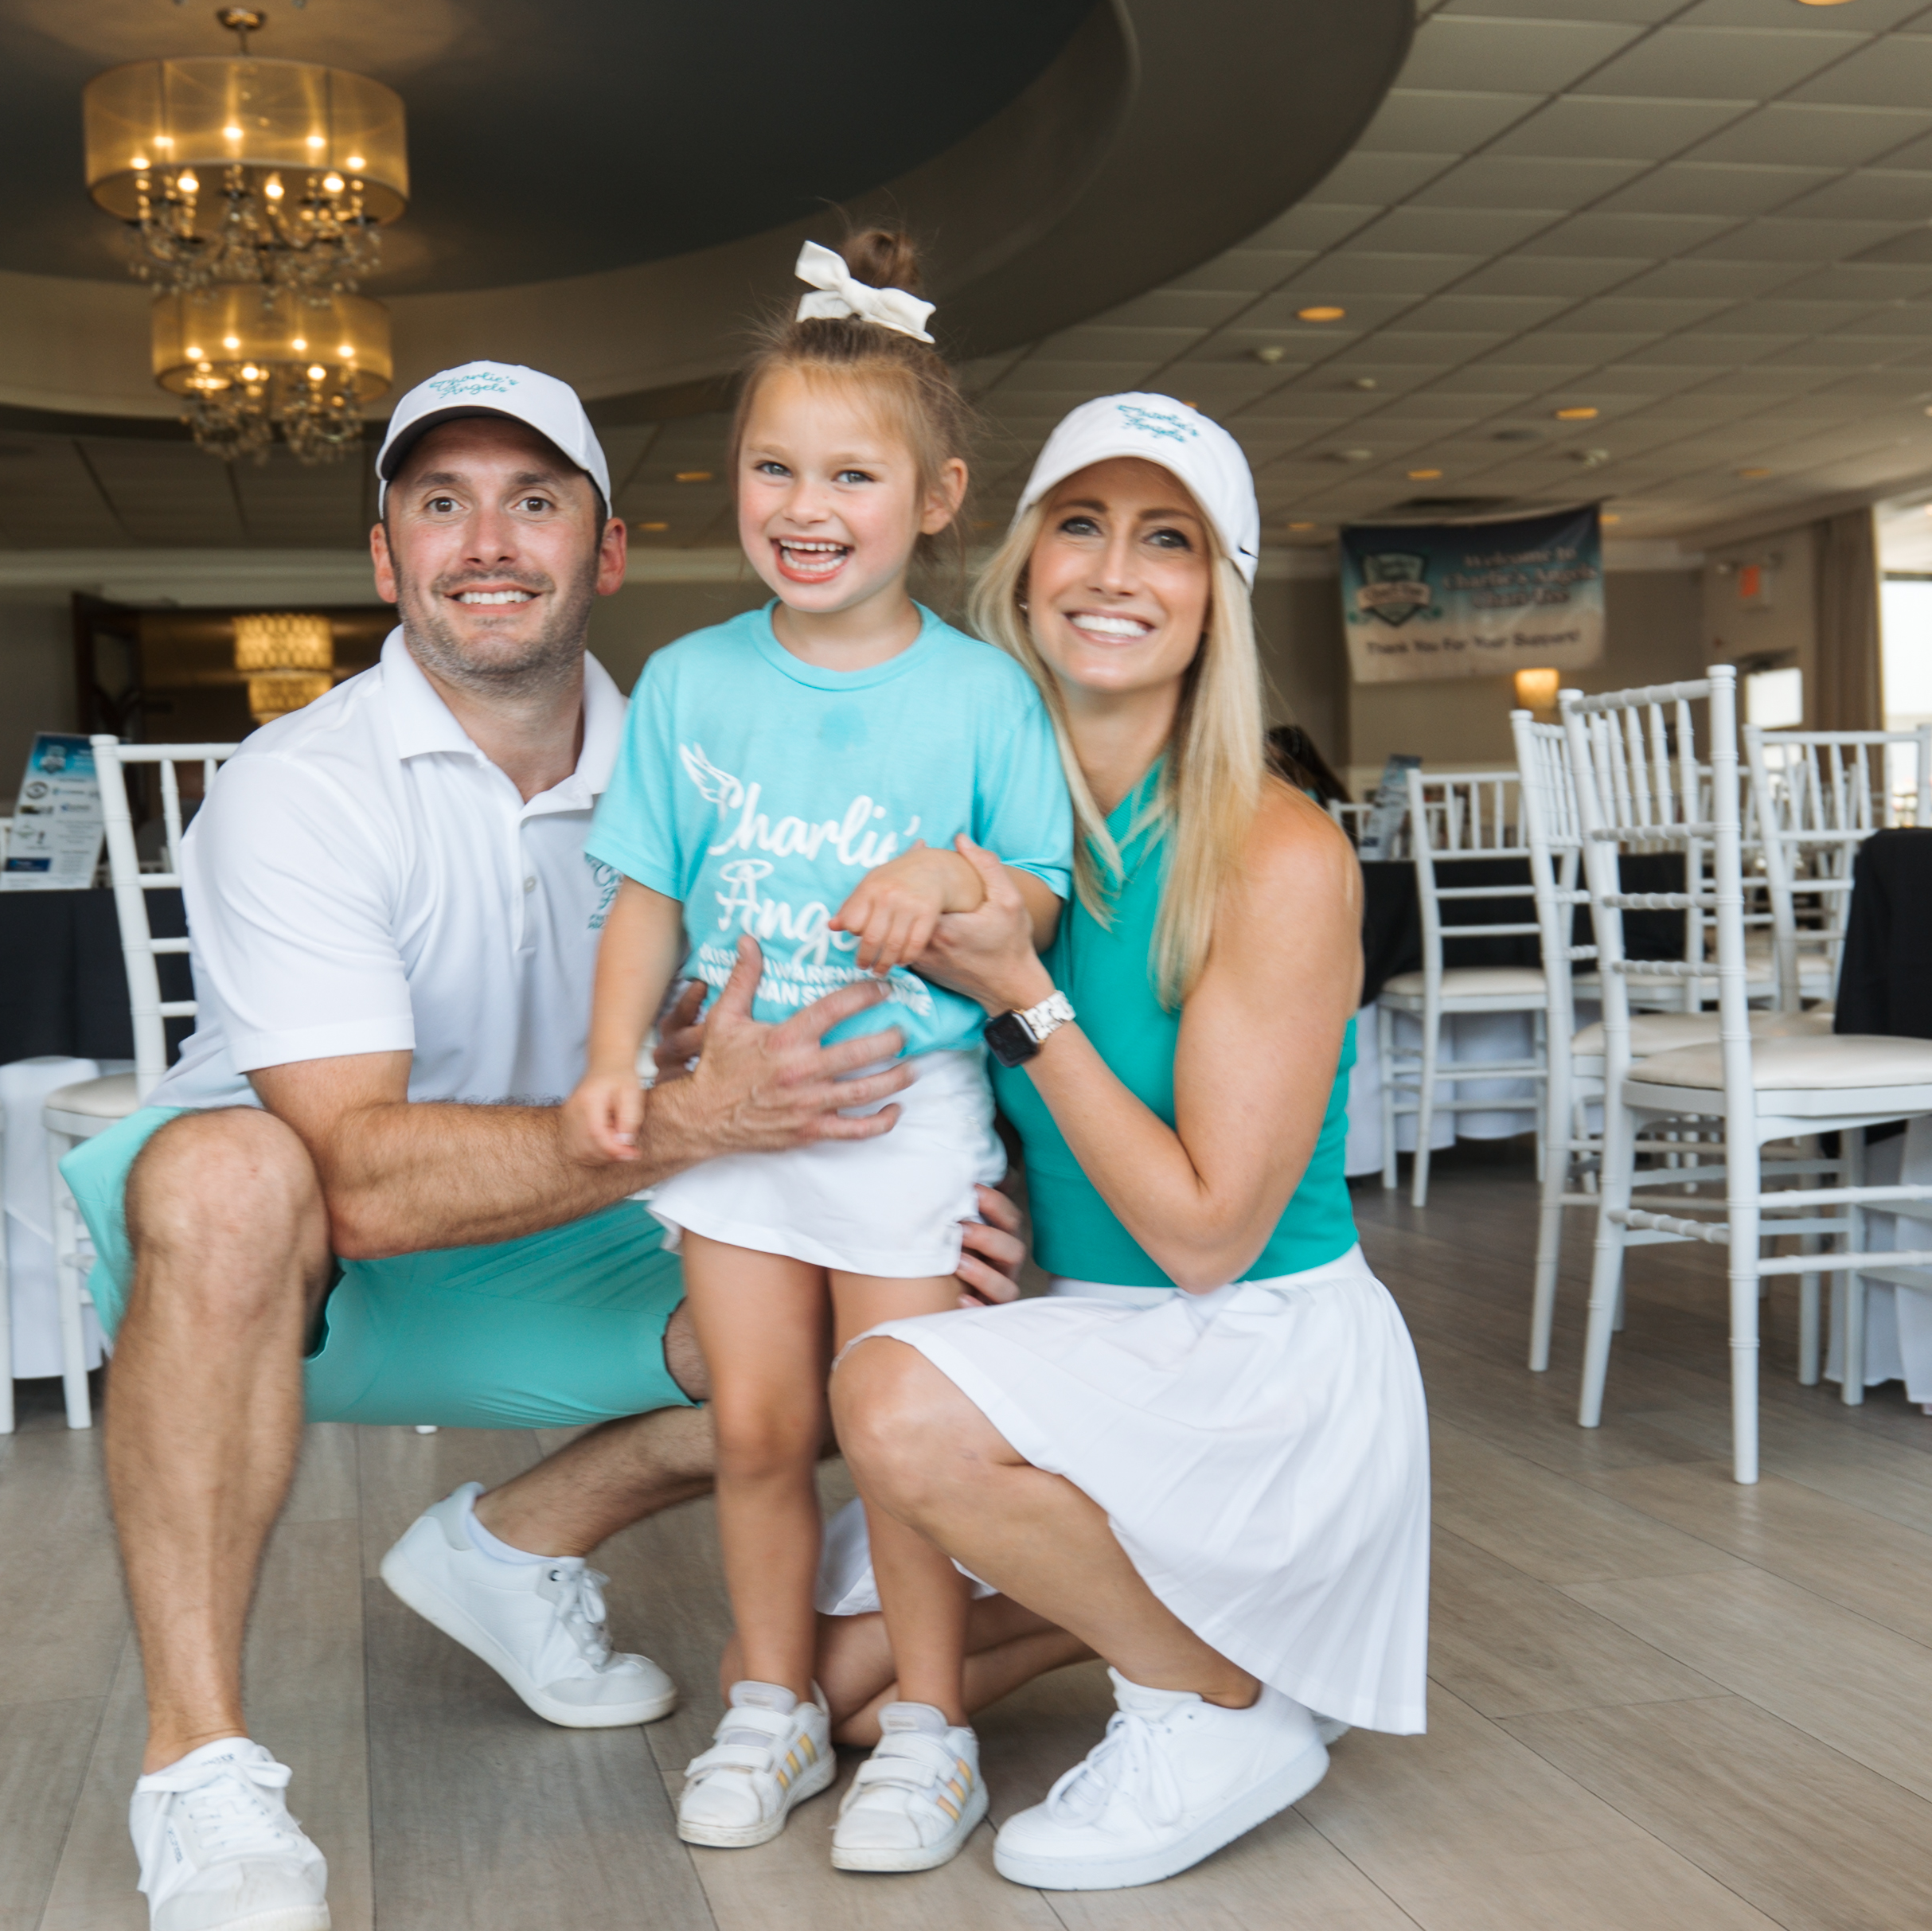
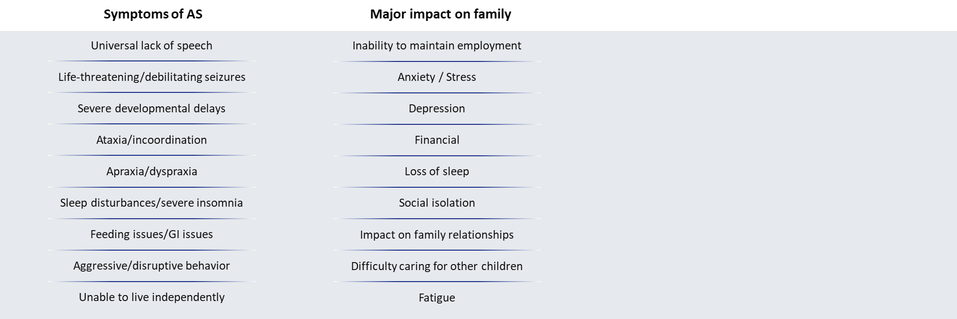
Severe Clinical Symptoms with Lifelong
Impact on Patients and Caregivers

Slide 12





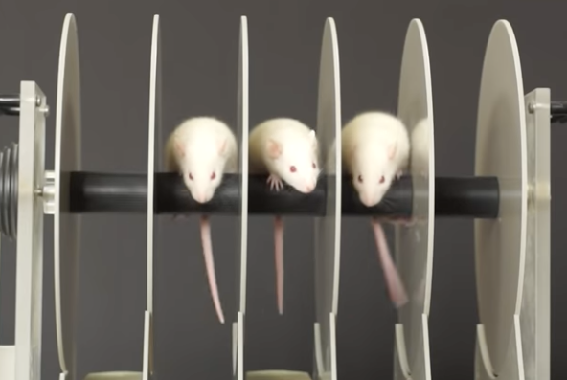
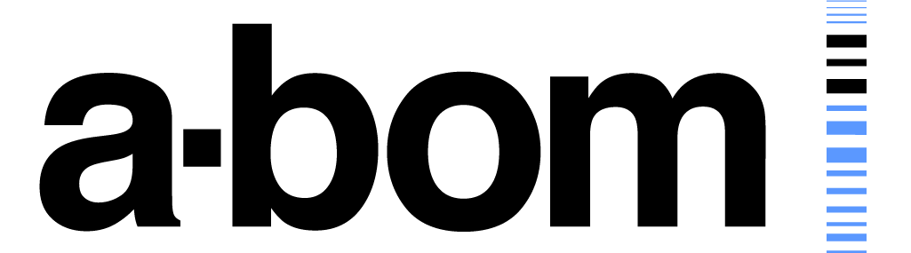







Bench to Bedside Roadmap
Holistic Approach Addressing Gaps and Therapeutic Development Challenges for AS
Over $60M invested in translational research since 2008 supporting 90+ grants
Discovery
Preclinical
Endpoints/Biomarkers
Community
Acceleration
Clinical trials
Academic Collaboration
Animal Testing
Pre-competitive Consortium
Natural History Data
Early-stage Development
KOL Network

Slide 13
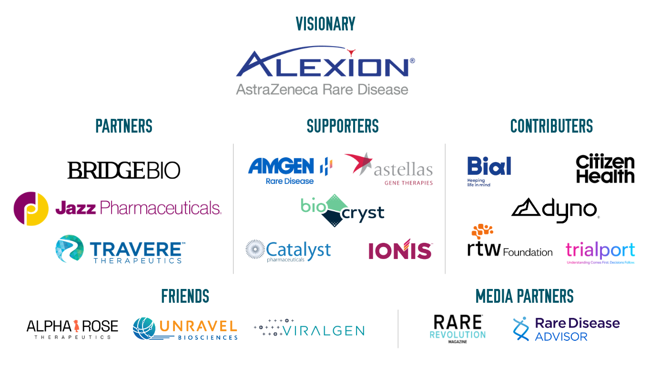
Thank you to our Sponsors!
#RDDS26

Slide 14


The 2026 RARE Drug Development Symposium is grateful to our valued Collaborators:
At Boston Children’s Hospital
#RDDS26

