Slide 1


September 9 – 11, 2026 | Boston, Mass

Slide 2

Market Access for Rare & Ultrarare Communities:
We Can’t Wait Until the Approval Comes
#RDDS26

Slide 3



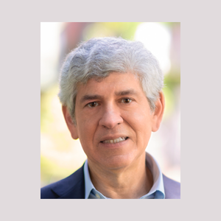
Market Access for Rare & Ultrarare Communities
Leora Schiff
Altius Strategy Consulting (Retired)
Dan Ollendorf, Ph.D.
ICER
Clark Paramore
Biogen
Michael Sherman, M.D.
GeneSprout

Slide 4
Data and Evidence in the Real World

Slide 5
Why do we generate data?
Data
Evidence
Claims
Decisions
Data is analyzed to create evidence
            Evidence supports claims
                Claims inform decisions

Slide 6
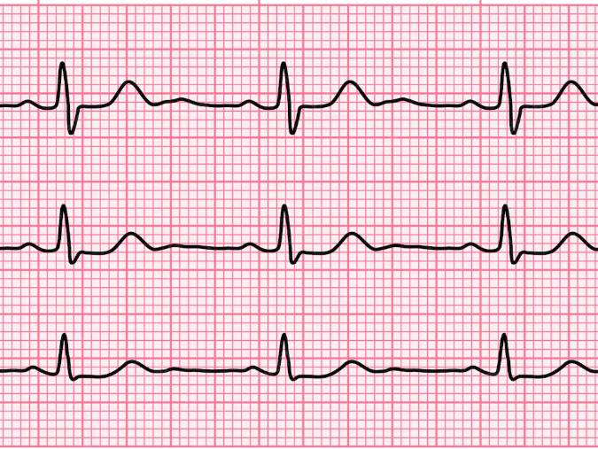
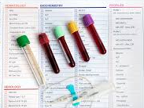
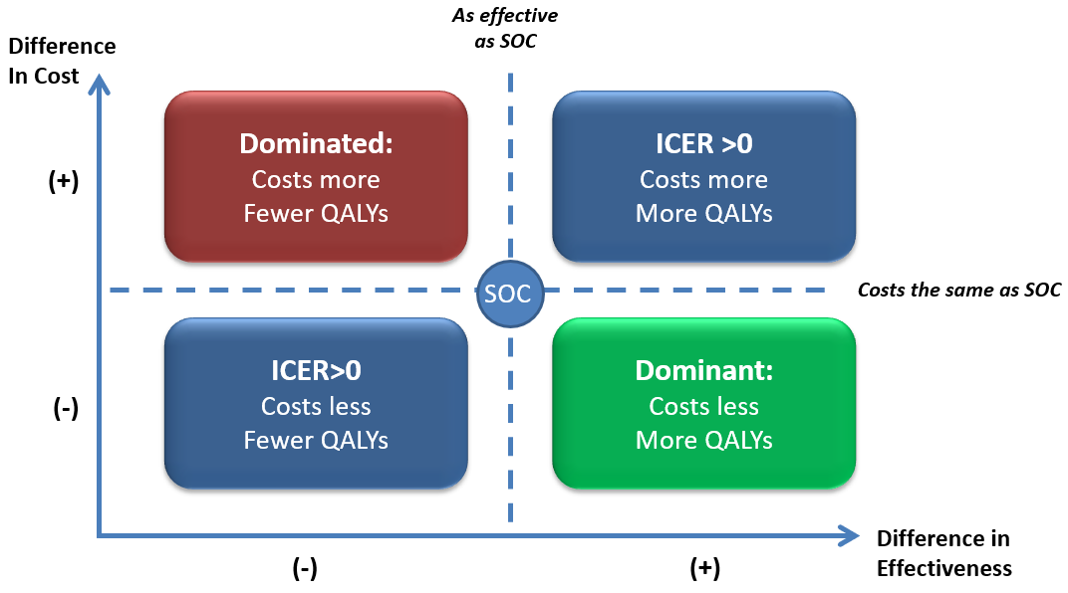
Some important definitions to keep in mind
Data
  Merriam-Webster Dictionary definition: “Factual information (such as measurements or statistics) used as a basis for reasoning, discussion, or calculation.”
  “Analytics in Action: What is data in simple words?” definition: “Data is . . . the raw materials which when processed and given meaning by people it becomes information.”
Evidence
  Oxford Languages Dictionary definition: “The available body of facts or information indicating whether a belief or proposition is true or valid.”
  https://ph.gauthmath.com/ definition: “A set of facts, data, or information used to support a point /claim.”
IMPORTANT NOTE
The process of generating evidence involves decisions regarding:
Data to be included in the analysis
Method of analysis used to generate evidence
#RDDS2026

Slide 7
Different kinds of evidence answer different questions
 | Can it work? (Efficacy) | Does it work? (Effectiveness) | Is it worth it? (Value)
Evidence Generation | Randomized Controlled Trials | Pragmatic Clinical Trials Observational Studies | Economic Models: e.g. Cost of Illness, Cost-Effectiveness Budget Impact
Evidence Synthesis | Systematic Review of CT Publications | Systematic Review of Evidence
Decision Making | Regulatory Approval (FDA) | Patient Care Decisions (Doctors, Hospitals) | Coverage / Reimbursement (Health Insurers)
Based on Luce BR et al. EBM, HTA, and CER: Clearing the Confusion. The Milbank Quarterly, Vol. 88, No. 2, 2010 (pp. 256–276).
#RDDS2026

Slide 8
Evidence quality varies depending on the methodology of analysis
There are many methods for generating evidence.
  However, the quality of a study differs in large part based on the study design.
  Randomized Clinical Trials / RCTs - the “gold standard”
  Expert opinion - the lowest level of evidence quality
However, RCTs often don’t make sense for the generation of evidence for rare disease treatments.
  Given the small populations, it is often difficult to recruit sufficient patients for both a treatment and a control group.
  In addition, patients at imminent risk of mortality do not want to be placed in control arms.
As alternative sources of control data, rare disease clinical trials may use data from:
  Natural history studies
  Control groups from published clinical studies
  Study patients as their own controls during a "run-in" period prior to the study treatment
Evidence Quality
Robust
Evidence
Randomized Clinical Trials (RCTs)
Cohort Studies
Case-control Studies
Case Studies
Weak
Evidence
Expert Opinion
Adapted from level of evidence table from https://www.cebm.ox.ac.uk/resources/levels-of-evidence/ocebm-levels-of-evidence

Slide 9


Why does evidence quality matter?
Evidence quality has a direct impact on planning:
  Stakeholders need to know how predictive the evidence is of outcomes in the real world
Increased uncertainty represents increased risk:
  Return on investment (ROI) for manufacturers
  Return on investment (ROI) for investors
  Cost to payers
  Cost / reputation to providers
  Health outcomes / cost to patients

Slide 10







Stakeholders use a variety of metrics in evaluating new health technologies
For example, Payers fall into different payer categories / archetypes based on the metrics that they use:
Comparative Clinical Effectiveness
Focus: incremental clinical benefit of a new intervention
Cost-Effectiveness
Focus: incremental cost per unit benefit of a new intervention
Budget Optimization
Focus: managing cost impact on healthcare budget
Competitive Free Pricing*
Focus: cost containment via drug utilization management
Mixed public / private
*IRA allows Medicare to negotiate prices

Slide 11
Key Takeaways
Different types of evidence answer different questions
  In designing your evidence plans, you need to clarify what questions need to be answered.
Different study designs result in different levels of evidence quality.
Stakeholders need to evaluate how predictive the evidence is of outcomes in the real world, so they can plan accordingly.
Uncertainty in evidence creates risk for stakeholders that they will need to mitigate.
Stakeholders apply different frameworks and metrics in evaluating evidence
  It is critical to understand how a specific stakeholder will evaluate your evidence.

Slide 12
It is essential for PAGs to understand where stakeholder interests overlap and where they diverge
There is nothing wrong with each stakeholder having their own interests.
However, stakeholder needs and incentives must be understood in order to have good collaborations.
Some stakeholder interests will result in pressure that drive them away from common goals.
The key is to understand these interests and how to help stakeholders overcome hurdles to meeting in the middle.
Patients & PAGs
Manufacturers
Government
Agencies
Health Insurers
What all stakeholders want:
Better treatments for rare disease patients
More patients to be able to get treated
Providers:
Doctors, Hospitals
#RDDS2026

Slide 13
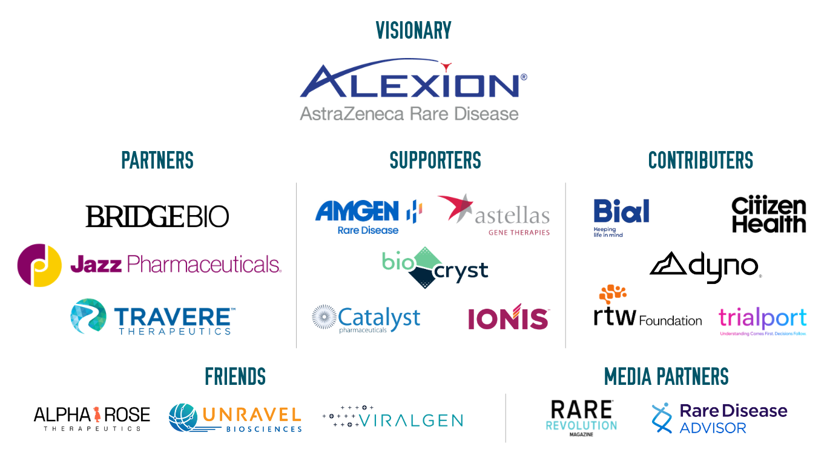
Thank you to our Sponsors!
#RDDS26

Slide 14


The 2026 RARE Drug Development Symposium is grateful to our valued Collaborators:
At Boston Children’s Hospital
#RDDS26

